Slide 1
BASICS OF
NUCLEAR REACTION
A general introduction to the main concepts of fusion, fusion vs. fission, solar fusion vs. fusion on Earth.
1
Graphic: EUROfusion, Reinald Fenke, CC BY 4.0, www.euro-fusion.org

Slide 2
m1
!
WE KNOW THAT TWO TYPES OF NUCLEAR REACTIONS EXIST:
FUSION & FISSION
2
Graphic: EUROfusion, CC BY 4.0, www.euro-fusion.org

Slide 3
m1
m1
FUSION
Two small nuclei bind making a bigger one.
FISSION
One large nucleus breaks up into smaller ones.
²H
³H
²³⁵U
²³⁶U
⁹²Kr
¹⁴¹Ba
n + 14.1 MeV
⁴He + 3.5 MeV
3
Graphic: EUROfusion, Reinald Fenke, CC BY 4.0, www.euro-fusion.org

Slide 4
m1
FUSION IS AN ENERGY SOURCE
The resulting atom is lighter than the initial ones. Where has the mass gone?
It is converted into energy, according to the famous equation from Albert Einstein:
E=mc²
In other words:
Energy = mass x speed of light squared
4
Graphic: EUROfusion, Reinald Fenke, CC BY 4.0, www.euro-fusion.org

Slide 5
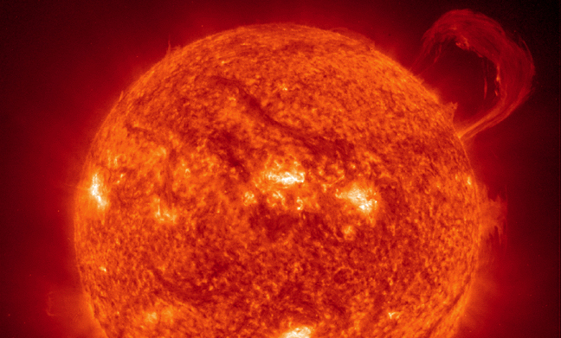
m1
FUSION WORKS
The sun and the stars shine thanks to fusion reactions taking place in their core.
5
Image: NASA

Slide 6
m1
HOW CAN WE DO THE SAME ON EARTH?
The Sun fuses Hydrogen (H) nuclei into Helium (He).
On Earth, the most efficient approach is to use two isotopes of Hydrogen:
• Deuterium (D)
• Tritium (T)
Proton
¹H
Deuterium
D
Tritium
T
¹
6
Image: EUROfusion, CC BY 4.0, www.euro-fusion.org

