Slide 1
m6
m10
FUSION POWER PLANT
80
Graphic: EUROfusion, Reinald Fenke, CC BY 4.0, www.euro-fusion.org

Slide 2
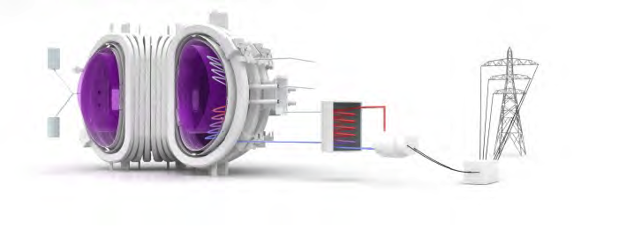
m6
m10
TIMELINE
The main issues to be solved:
Efficient tritium breeding technologies
The wall materials
Main goal:
Future designs with continuous operation
ITER DEMO Commercial Fusion Power Plants
81
Image: EUROfusion, CC BY 4.0, www.eurofusion.org

Slide 3
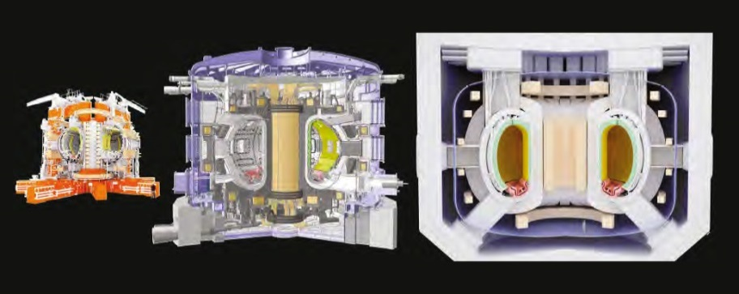
m6
m10
FROM THE EXPERIMENT TO THE POWER PLANT
Future of Fusion
Today
Tomorrow
The Future
Commercial Fusion Power Plant
82
Image: EUROfusion, CC BY 4.0, www.eurofusion.org

Slide 4
m6
m10
DEMO
The next step on the way to realise fusion energy
The results obtained from the exploitation of ITER and other fusion experiments
Confirm the technological feasibility of fusion and demonstrate its commercial viability
The first fusion device to export significant amounts of electrical power from fusion
83
Image: EUROfusion, CC BY 4.0, www.eurofusion.org

Slide 5
m6
m10
THE POWER PLANT CONCEPTUAL STUDY
steady state operation
friendly man-machine interface
40 years lifetime (the possibility of further extension up to 60 years)
an availability of 75–80%
only a few short unplanned shutdowns should occur in a year
DEMO Operations
Commercial Fusion Power Plant
84

Slide 6
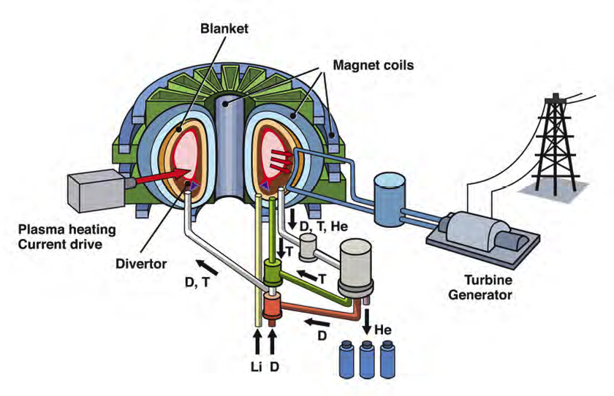
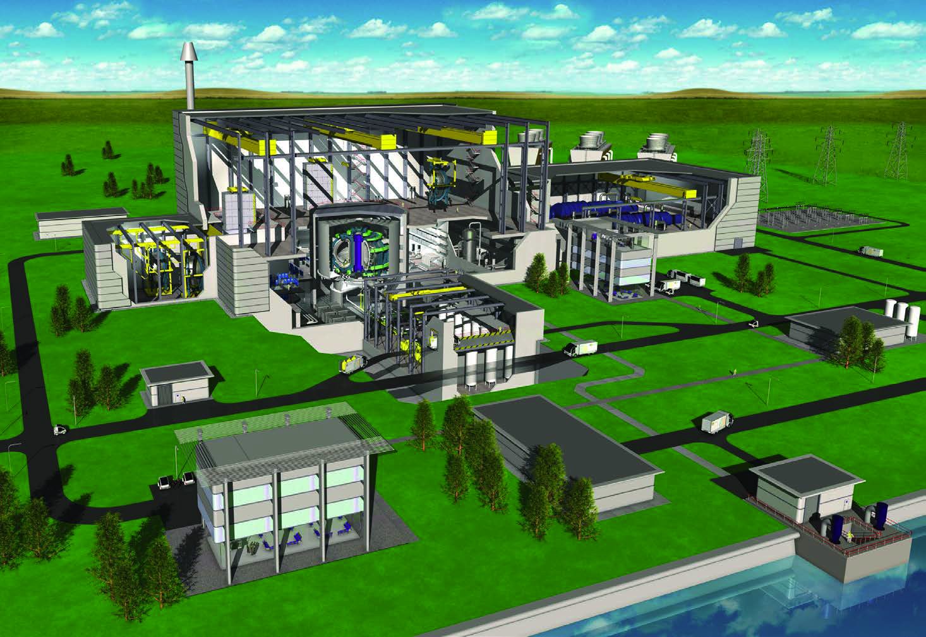
m6
m10
FINAL STEP – COMMERCIAL FUSION POWER PLANT
An artist's impression based on European fusion power plant design.
© EFDA
85

