Slide 1
m6
m9
FUSION EVOLUTION ROADMAPS
Graphic: EUROfusion, Reinald Fenke, CC BY 4.0, www.euro-fusion.org

Slide 2
m6
m9
THE PROGRESS IN FUSION RESEARCH
M°C
Electrical Power?
High Energy
ITER: Material Testing
1000
100
10
1
0
Burning Plasma
2005: Performance Enhancement
Proof of Principle
Understanding
Concept
1993:
Energy in = 12 MW
Energy out = 6 MW
1970 1980 1990 2000 2010 2020 2030 onwads
Graphic: EUROfusion, Reinald Fenke, CC BY 4.0, www.euro-fusion.org

Slide 3
m6
m9
THE ROAD TO FUSION ELECTRICITY
Fusion electricity by 2050
The fusion community support ITER in all possible ways
Research focusses on the needs of a power plant
Image: EUROfusion, CC BY 4.0, www.eurofusion.org

Slide 4
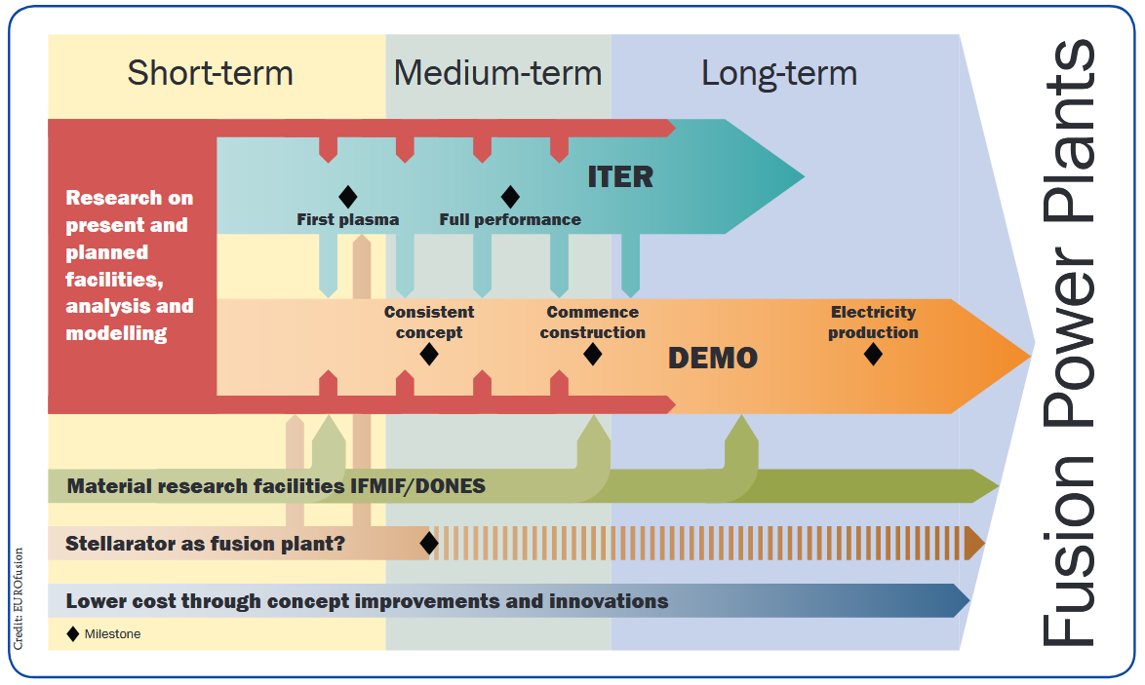
m6
m9
ROADMAP TO FUSION ELECTRICITY
A European and worldwide effort

