Slide 1
m6
m11
€
ENERGY RESOURCES AND COST OF FUSION

Slide 2
m6
m11
WORLD ENERGY MIX
Growth prospects for world primary energy demand
2009 12.13 billion toe
2035 16.96 billion toe
6% Nuclear
7% Nuclear
1% other renewables
2% Hydroelectric
3% Hydroelectric
4% other renewables
10% other renewables
11% other renewables
33% Oil
28% Oil
1.3% annual growth
27% Coal
24% Coal
21% Natural Gas
3% Natural Gas
What after 2035? Do we need an energy of the future? Yes. Fusion.
Source: World Energy Outlook 2011, International Energy Agency (IEA)

Slide 3
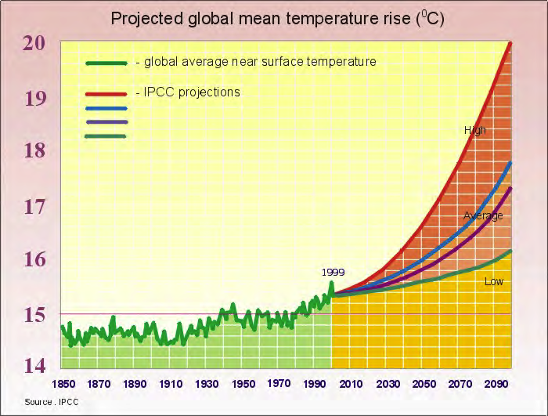
m6
m11
CLIMATE CHANGE TEMPERATURES
We need a clean energy. Fusion is carbon free solution.

Slide 4
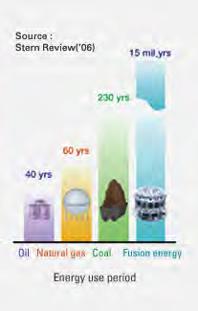
m6
m11
ENERGY RESOURCES
Unlimited energy resources for fusion
Fusion will be an optimal alternative to the existing energy sources

Slide 5
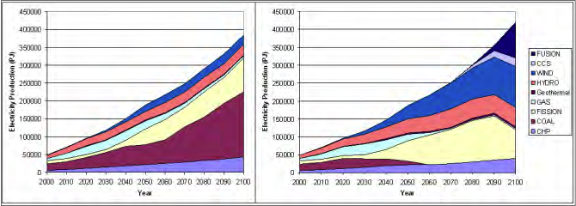
m6
m11
FUSION AS A PART OF ENERGY SCENARIOUS
Energy scenarios until 2100 derived from the EFDA TIMES model

Slide 6
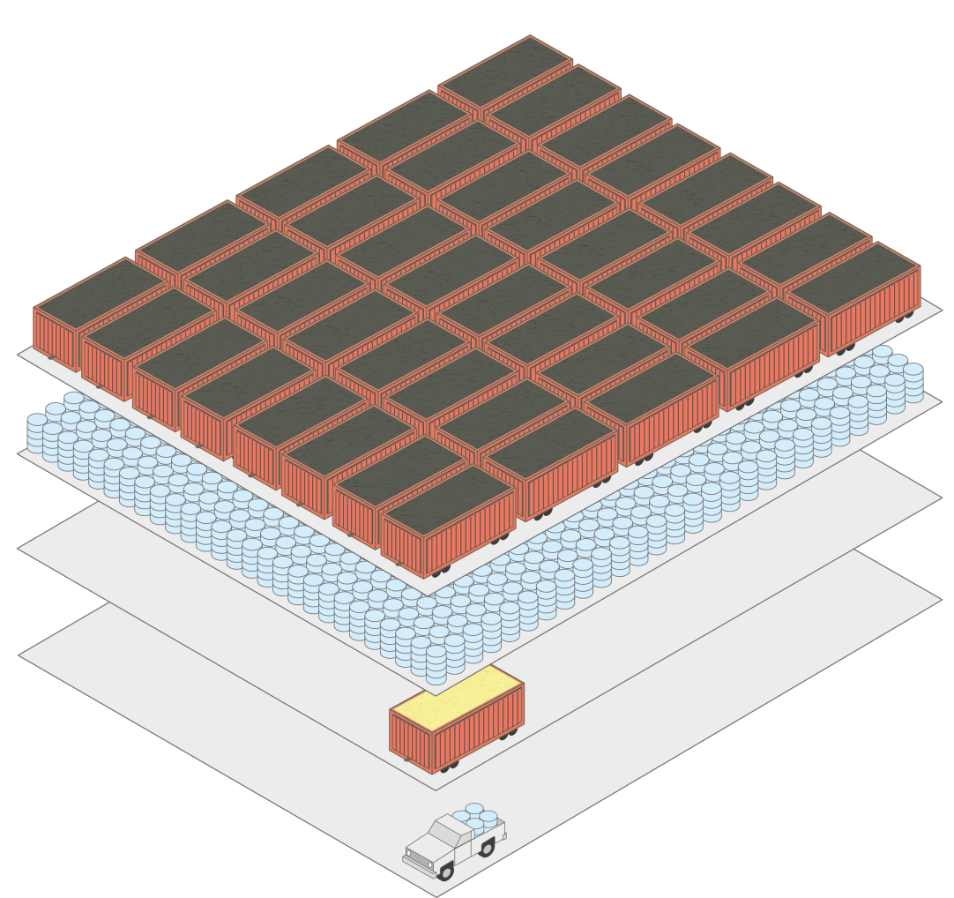
m6
m11
HOW MUCH FUEL WILL WE NEED FOR ONE YEAR OF OPERATION OF 1000 MW POWER PLANT
≈2.000.000 Tonnes (21.010 Railcar Loads)
Coal
≈1.300.000 Tonnes (10.000.000 Barrels)
Oil
≈30 Tonnes UO₂ (one railcar load)
Fission
≈0.6 Tonnes D (one pickup truck)
Fusion
Fusion energy is more efficient than fission or burning oil/coal.

Slide 7
m6
m11
WHY IS WORTH TO INVEST IN FUSION?
New energy without greenhouse gases
Many advantages: Sustainable source of energy
Unlimited fuels
Base load capacity operation

Slide 8
m6
m11
ECONOMICS OF FUSION POWER
Economic comparison should be made with energy sources with comparable acceptability
Licensing requirements and regulatory constraints should be strongly reduced compared to fission plants
The construction time should be minimized - No more than 5 years
Standardization should be pursued as much as possible

Slide 9
m6
m11
PPCS model | A | AB | B | C | D
Unit size (Gwe) | 1.55 | 1.50 | 1.33 | 1.45 | 1.53
Internal Cost EUR cents/kWh | 5-9 | 5-9 | 4-8 | 4-7 | 3-5
External Cost EUR cents/kWh | 0.09 | 0.08 | 0.07 | 0.06 | 0.06
COST OF FUSION
Power plant conceptual studies (PPCS) in Europe
Cost of electricity for the five PPCS models
Internal Costs
Construction
Fuelling
Operations
Disposal
External costs
Health effects
Socio-economic impact

Slide 10
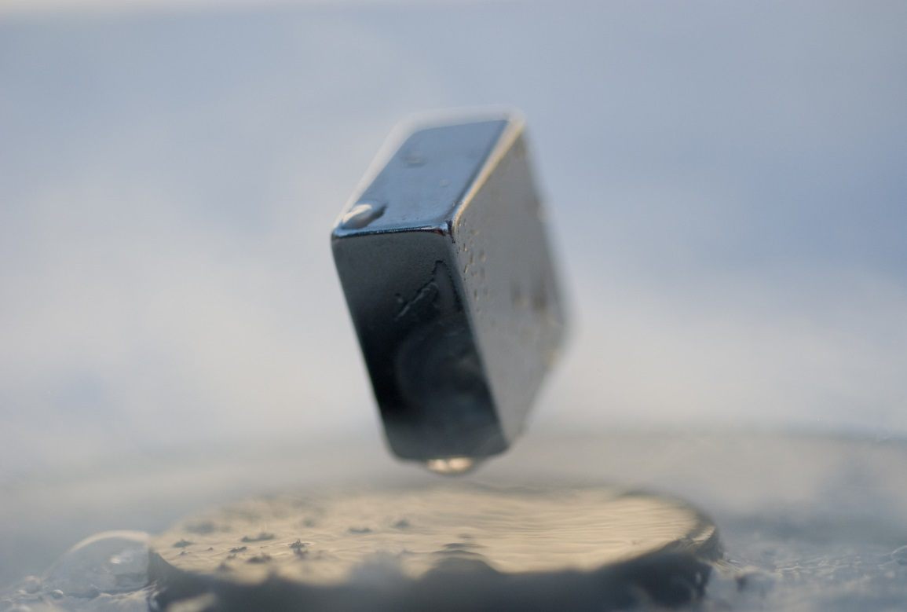
m6
m11
FUSION SPIN-OFFS: SUPERCONDUCTORS
Powering advances in the superconducting industry
Image source: By Julien Bobroff (user:Jubobroff), Frederic Bouquet (user:Fbouquet),
Jeffrey Quilliam, LPS, Orsay, France [CC BY-SA 3.0] via Wikimedia Commons

Slide 11
m6
m11
FUSION SPIN-OFFS: CELLULAR NEURAL NETWORKS (CNNS) FOR DATA PROCESSING
Driving improvements in hardware systems used for real-time image processing.
Image source: Pixabay.com, free download

Slide 12
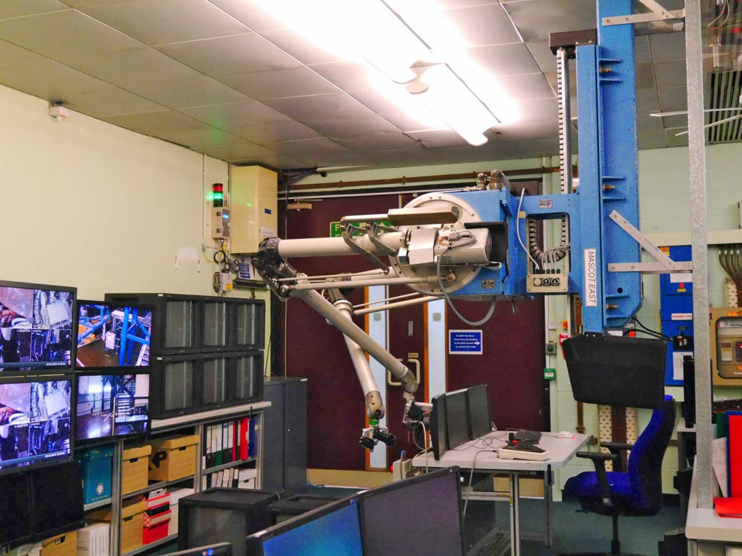
m6
m11
FUSION SPIN-OFFS: REMOTE HANDLING
Fine-tuning remote handling techniques
Image source: EUROfusion

