Slide 1
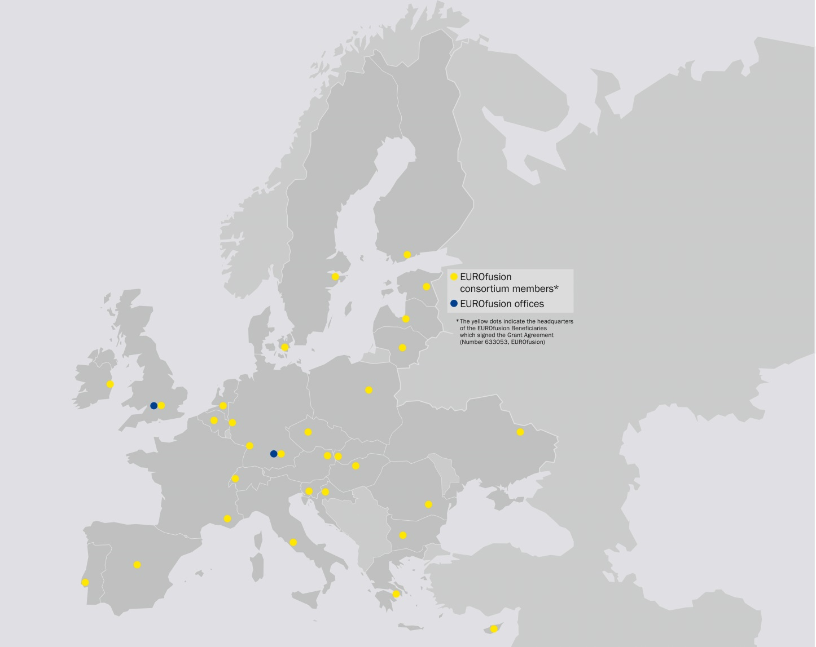
m6
m12
EUROfusion
The European Consortium for Development of Fusion Energy
Picture source: EUROfusion

Slide 2
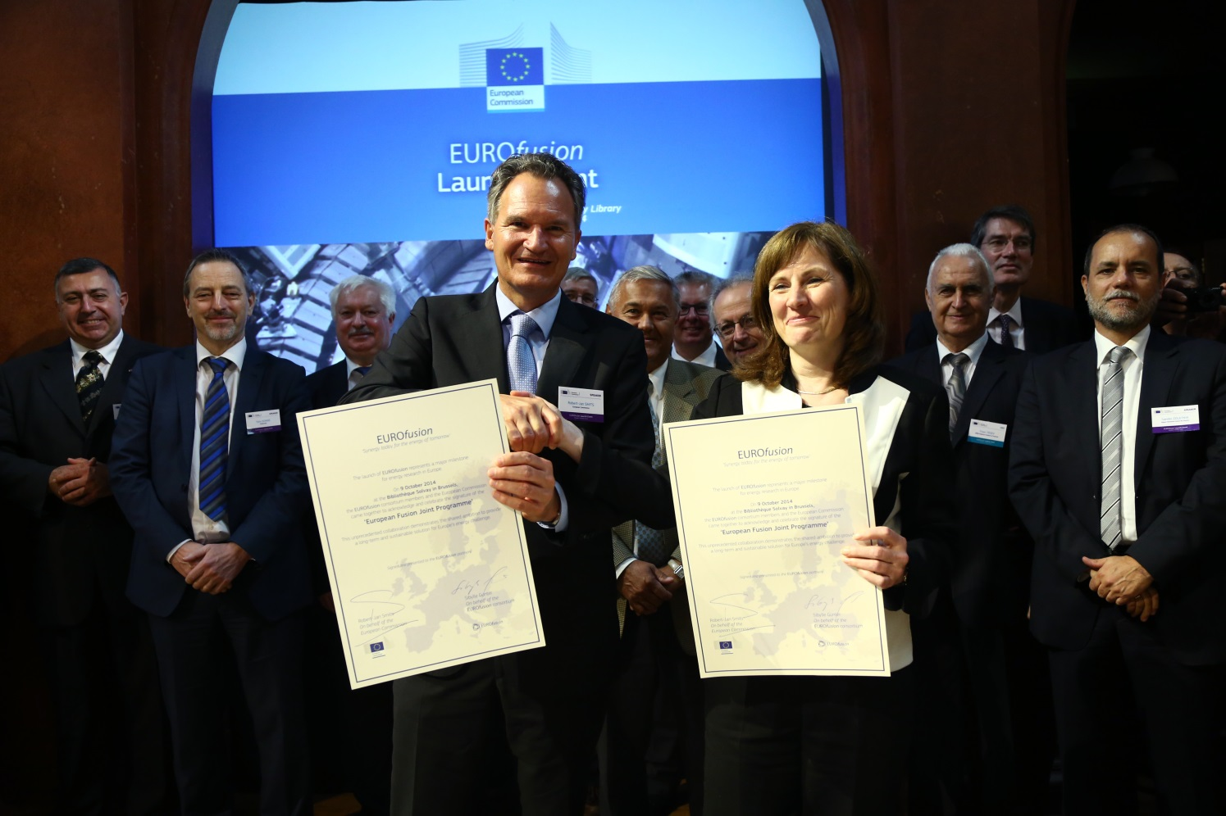
m12
The Beginnings
On October 9 2014, fusion research bodies from European Union member states and Switzerland signed an agreement to cement European collaboration on fusion research and EUROfusion was born. Ukraine joined in 2017.
Picture source: EUROfusion

Slide 3
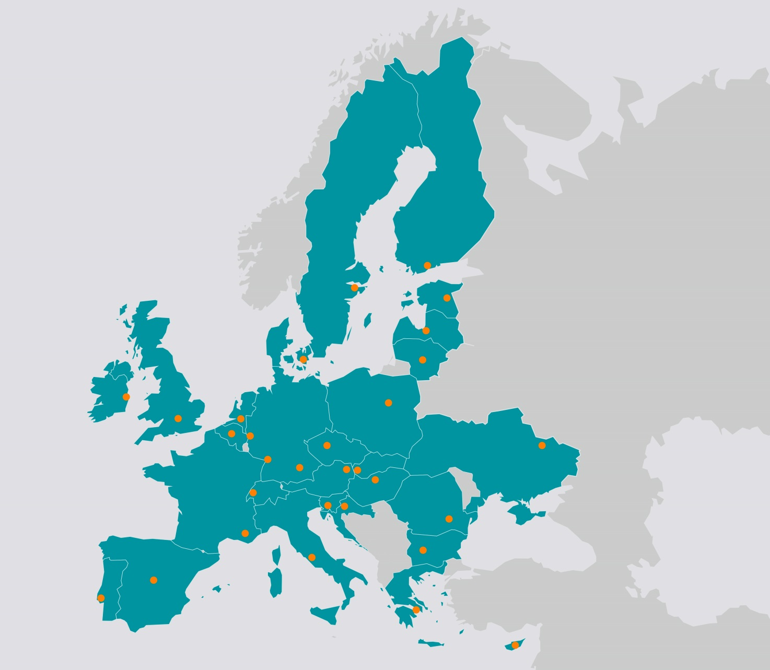
m12
Consortium Members
As of 2019, 30 research organisations and universities from 26 European Union member states plus Switzerland and Ukraine are members of the EUROfusion consortium.
Picture source: EUROfusion

Slide 4
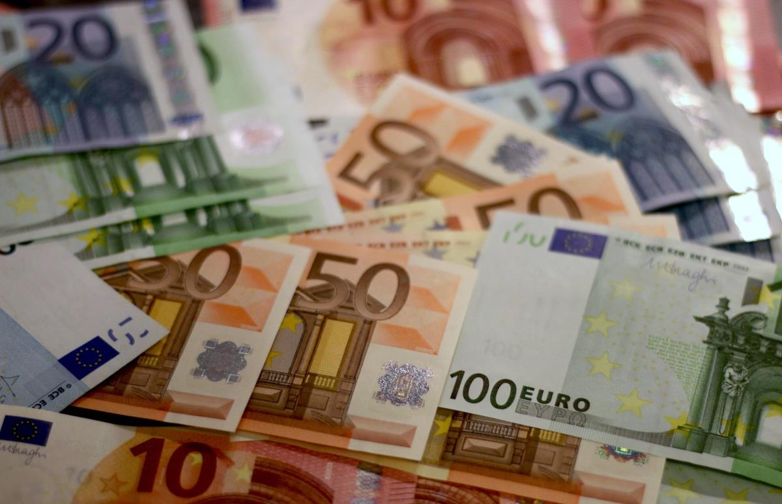
m12
Budget
€440 million from EURATOM H2020
€410 million from member states

Slide 5
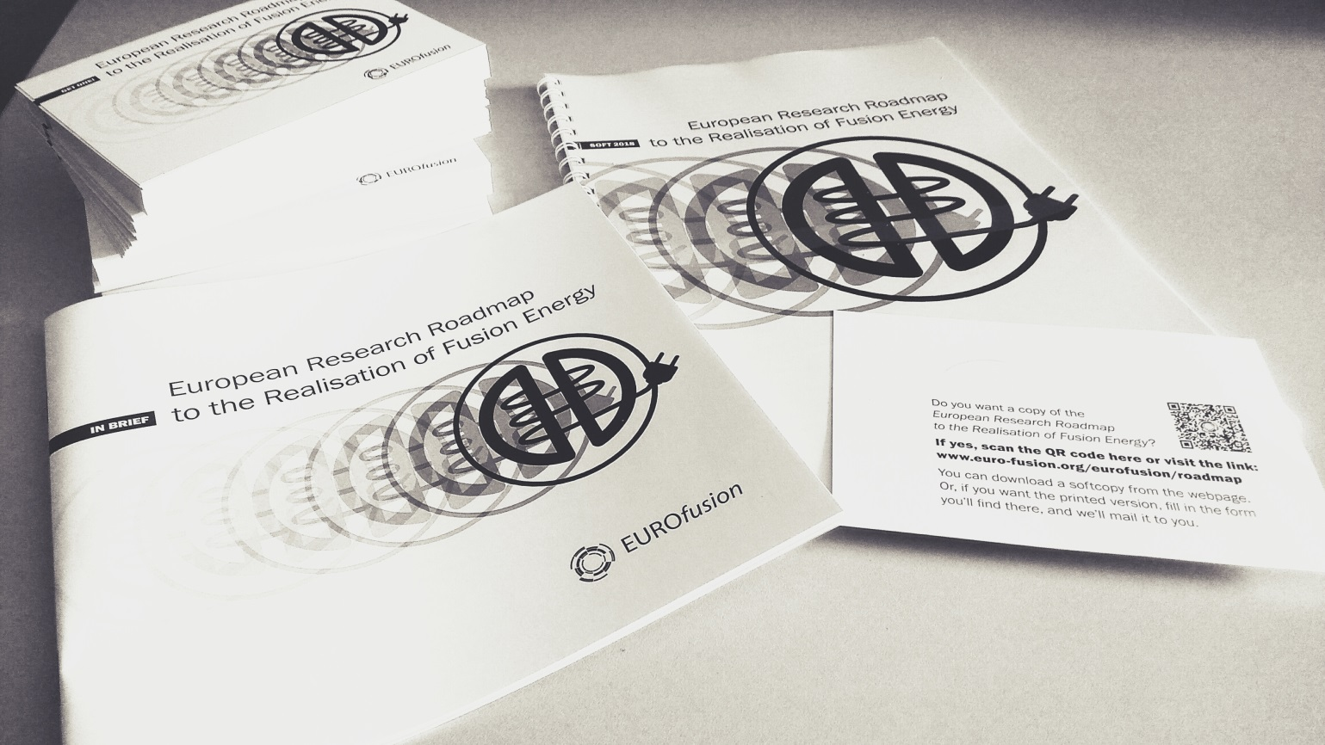
m12
EUROfusion Mission
To pave the way for fusion power reactors.
EUROfusion funds the research in its 30 members on the basis of the 'Roadmap to the Realisation of Fusion Energy' . This is done as a Joint Programme within Euratom Horizon 2020.
Picture source: EUROfusion

Slide 6
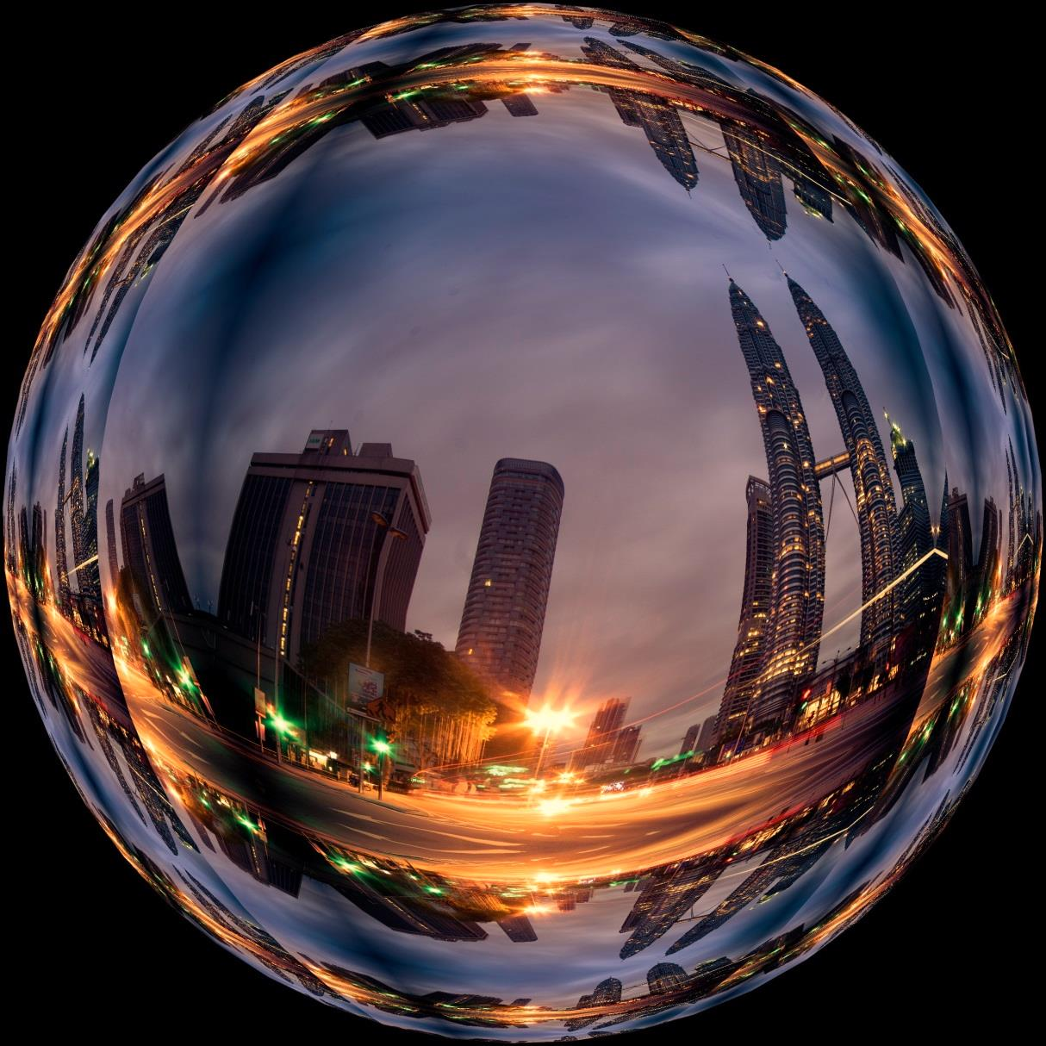
m12
Vision
The consortium’s vision is a world in which fusion power plants feed the grid with CO2-free fusion power and complement other sources of energy production.

Slide 7
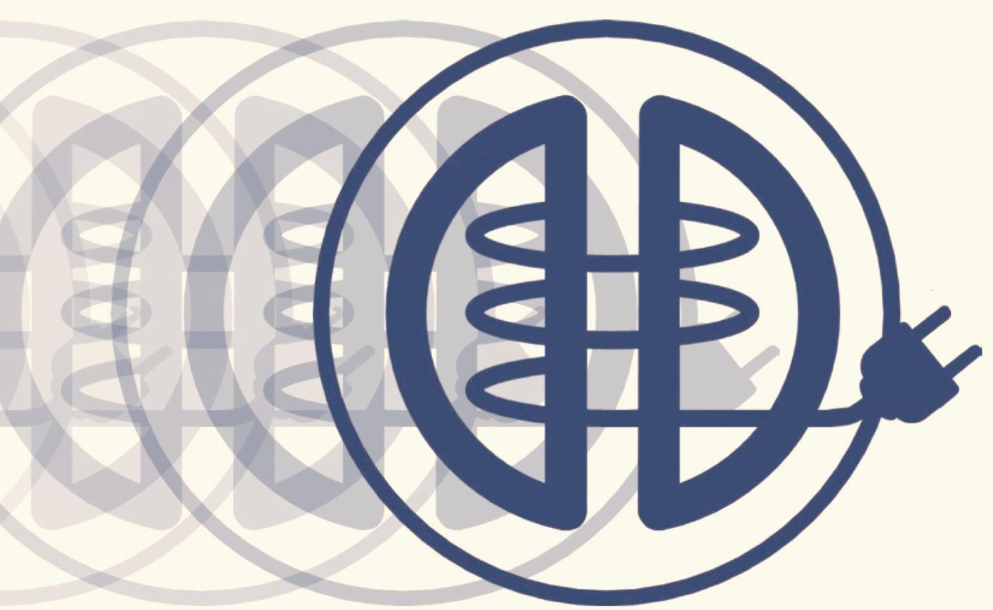
m12
The EUROfusion Roadmap
Is the basis for the programmes of EUROfusion
Provides a clear and structured way forward to commercial electricity from fusion.
Outlines how consortium members receive funding for fusion projects according to their participation in the missions and experiments.
Picture source: EUROfusion

Slide 8
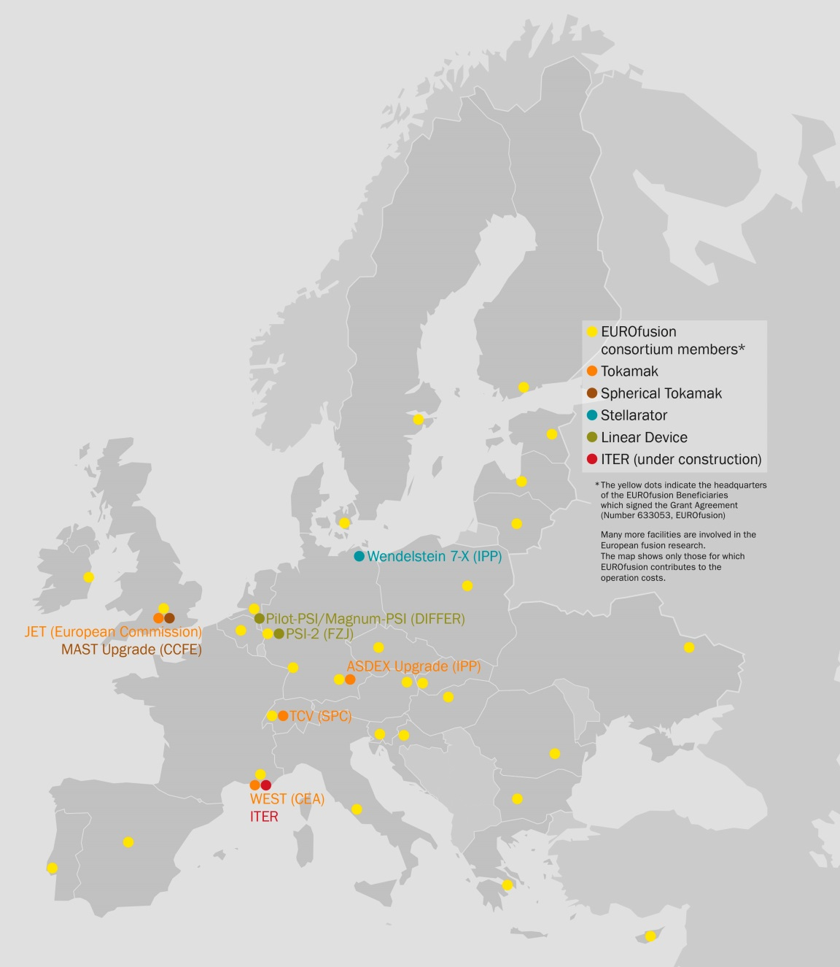
m12
Fusion experiments
JET, the Joint European Torus is EUROfusion’s flagship device
Other experiments that contribute directly to the Roadmap missions:
Medium Sized-Tokamaks: ASDEX Upgrade, MAST Upgrade, and TCV.
Linear Devices: Magnum PSI, PSI-2
Other tokamaks: WEST
Stellarator: Wendelstein7-X
Picture source: EUROfusion

Slide 9
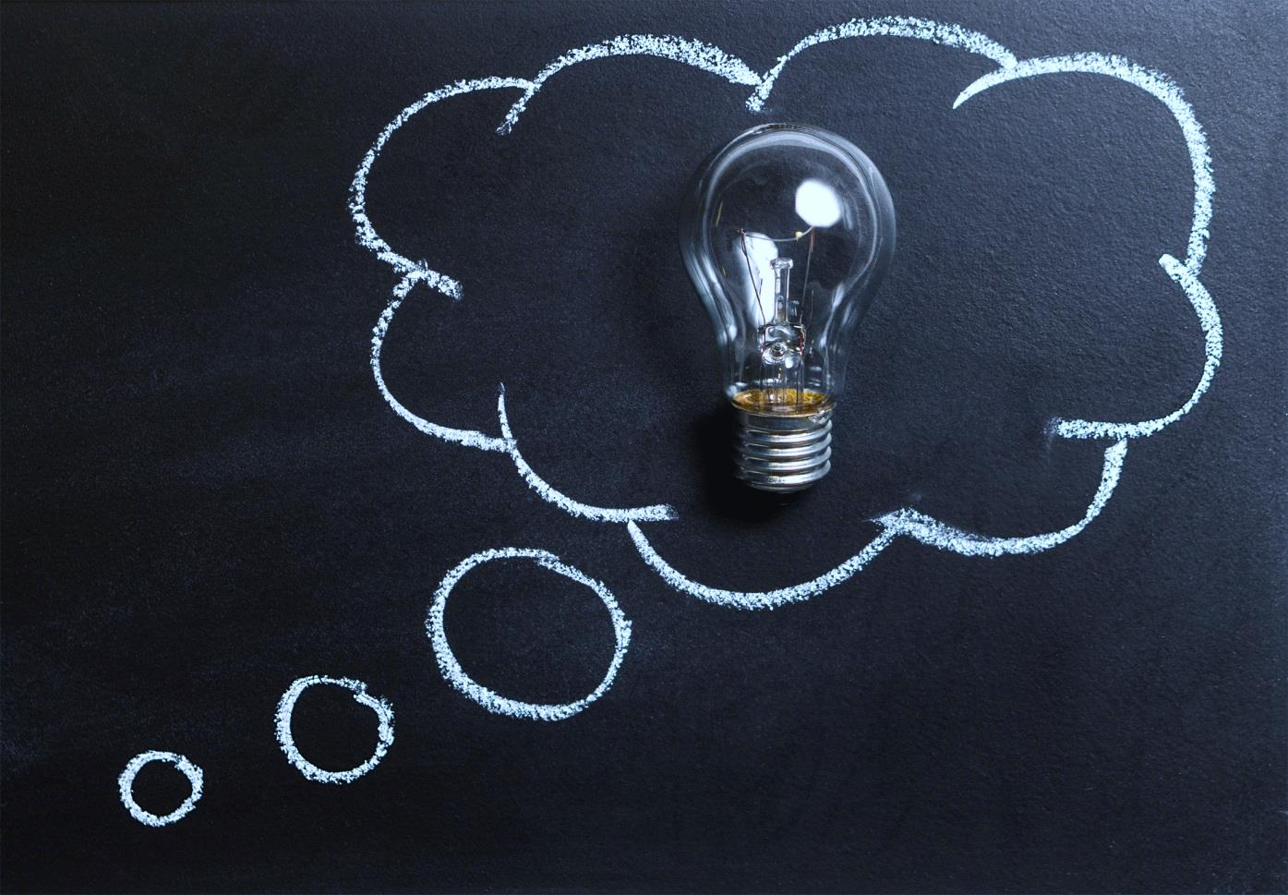
m12
Education & Training, Research Grants
EUROfusion supports fusion education and training through the EUROfusion Research Grant and EUROfusion Engineering Grant schemes.
EUROfusion’s Enabling Research scheme backs diverse research projects in the consortium member laboratories.

Slide 10
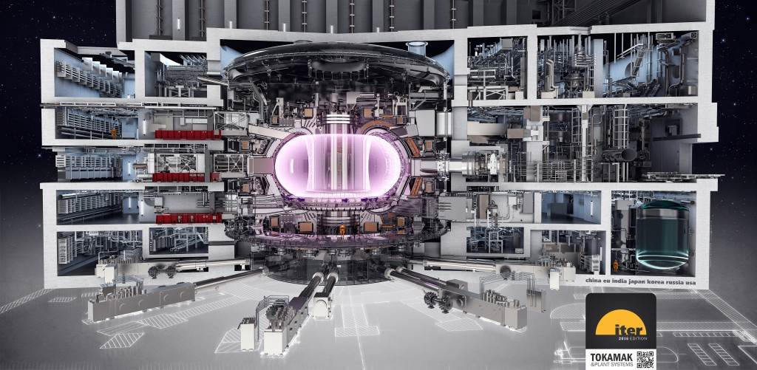
m12
ITER
At the heart of all EUROfusion activities lies ITER, the next generation fusion experiment which is currently being built in France. Once built, ITER will pave the way to making fusion energy a reality.
Picture source: ITER

Slide 11
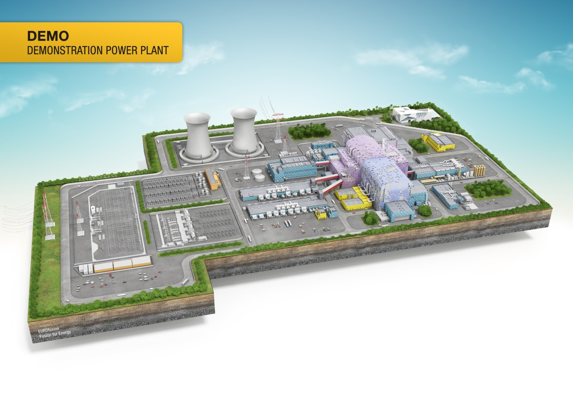
m12
Realising fusion electricity
Looking beyond ITER, EUROfusion researchers and engineers are working on designing DEMO, the demonstration power plant that will hook fusion electricity to the grid and show that fusion can help meet our future energy needs.
Picture source: EUROfusion

