Slide 1
m1
m2
HOW TO CREATE FUSION ON EARTH
Introduction to the
concepts of ignition, density, confinement and Magnetic Confinement Fusion.
7
Graphic: EUROfusion, Reinald Fenke, CC BY 4.0, www.euro-fusion.org

Slide 2
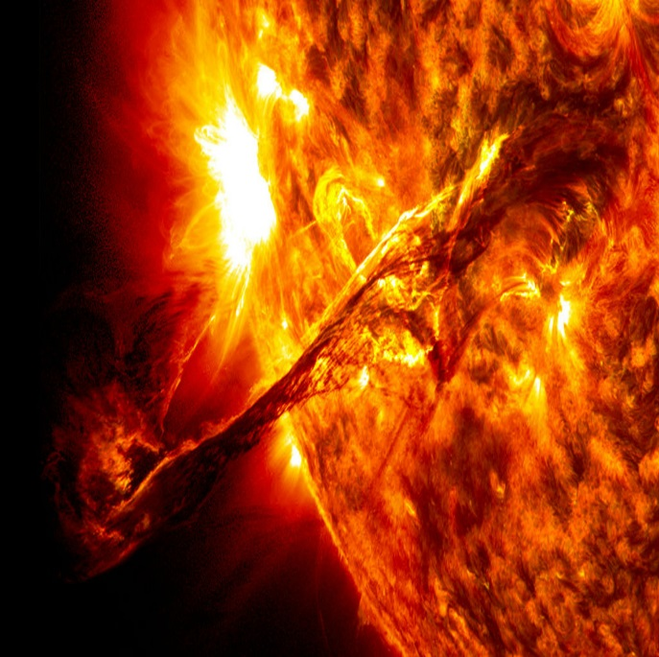
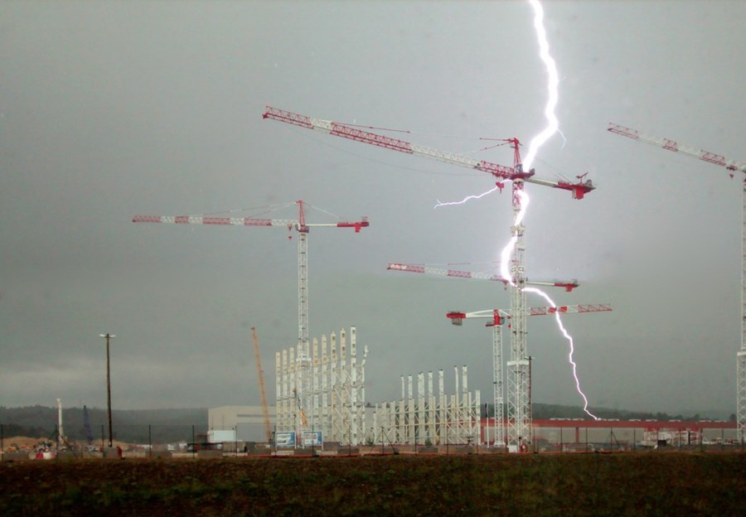
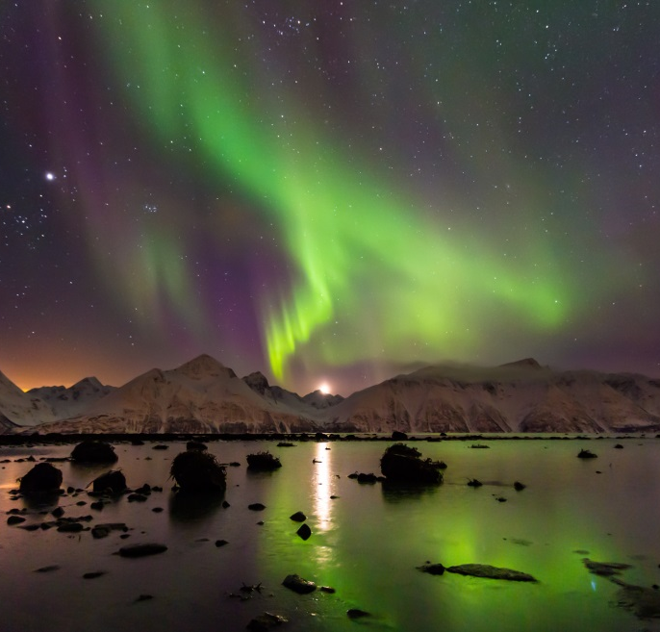
m2
Plasma is the most common state of matter in the universe. It makes up 99% of all Observable matter.
1
2
100 million degrees are required to overcome the repulsion between nucleii. Inside a deuterium-tritium fusion reactor matter enters the state of plasma.
8
3
Image 1: prominence on the Sun, By NASA Goddard spaceflight center [public domain], via Wikimedia Commons. Image2: ITER Organization, www.iter.org
Image 3: By Carsten (Flickr: Polarlicht-Reise 2013 - Tag09 - 22) [CC BY 2.0 (http://creativecommons.org/licenses/by/2.0)], via Wikimedia Commons

Slide 3
m2
The Four States of Matter
Heating solid substance leads to melting, it becomes liquid. Heating fluid leads to gas phase. Heating of gas leads to plasma.
❄
nuclei⁺
electron⁻
9
Graphic: EUROfusion, Reinald Fenke, CC BY 4.0, www.euro-fusion.org

Slide 4
m2
IGNITION: CREATING A SELF-SUSTAINING FUSION REACTION
In order to start a fusion reaction you have to simultaneously:
Understanding plasma physics is essential for creating fusion.
1
keep its
temperature high
2
keep the plasma
confined in volume
3
prevent it from
losing heat
10
EUROfusion, CC BY 4.0, www.euro-fusion.org

Slide 5

m2
high density
DENSITY IS A MEASURE OF
HOW CROWDED
A SYSTEM IS
low density
12
12
Image: By No machine-readable author provided. Ed g2s assumed (based on copyright claims). [GFDL (http://www.gnu.org/copyleft/fdl.html), CC-BYSA-3.0
(http://creativecommons.org/licenses/by-sa/3.0/) or CC BY-SA 2.5-2.0-1.0 (http://creativecommons.org/licenses/by-sa/2.5-2.0-1.0)], via Wikimedia Commons

Slide 6
m2
Heat losses
❄
Roof 25-30%
CONFINEMENT TIME IS A MEASURE OF HOW WELL A SYSTEM IS INSULATED
Windows
25-30%
Walls 25-30%
Floor 10-20%
13
Graphic: EUROfusion, Reinald Fenke, www.euro-fusion.org

Slide 7
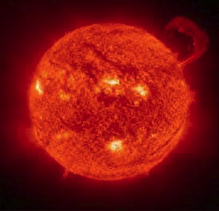
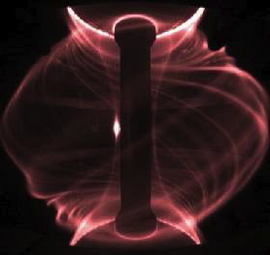
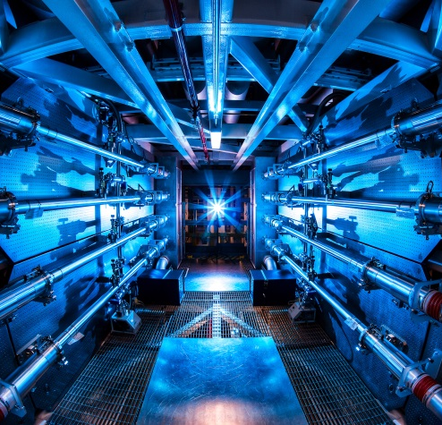
m2
m2
PLASMA CONFINEMENT IS
THE KEY TO ACHIEVING FUSION
Stars are so massive
that they rely on
On Earth nuclear fusion does not happen naturally, so we rely mainly on two approaches
gravitational
confinement
magnetic
confinement
inertial
confinement
14
Images(left to right): NASA, CCFE, green picture replace with https://en.wikipedia.org/wiki/National_Ignition_Facility#/media/File:Preamplifier_at_the_National_Ignition_Facility.jpg,
image: Lawrence Livermore National Laboratory, CC BY-SA 3.0, http://tinyurl.com/hj7qvan

Slide 8
m2
MAGNETIC CONFINEMENT FUSION
The plasma is squeezed and its particles spiral along magnetic field lines, while electric fields heat it
Density is very low:
250 thousand times
less than the Earth’s atmosphere
Confinement time is
long: >seconds
No magnetic field
N
With magnetic field
Electron
Magnetic field line
S
15
Graphic: EUROfusion, Reinald Fenke, CC BY 4.0, www.euro-fusion.org

