Slide 1
m3
m3
FUSION DEVICES AND THE HISTORY OF FUSION RESEARCH
16
Graphic: EUROfusion, Reinald Fenke, CC BY 4.0, www.euro-fusion.org

Slide 2
m3
m3
EARLY CONCEPTS: LINEAR PINCH DEVICE
Cylindrical magnetic chamber enclosing a hot plasma, with an electric current ‘pinching’ the plasma and keeping it away from the wall
Problem with energy losses at each end of the container
Charges in a magnetic field
Photo of pinch device from Wikipedia – released for public domain use: http://commons.wikimedia.org/wiki/File:Z-pinch_H-gamma.jpg
17
Graphic: EUROfusion, Reinald Fenke, CC BY 4.0, www.euro-fusion.org

Slide 3
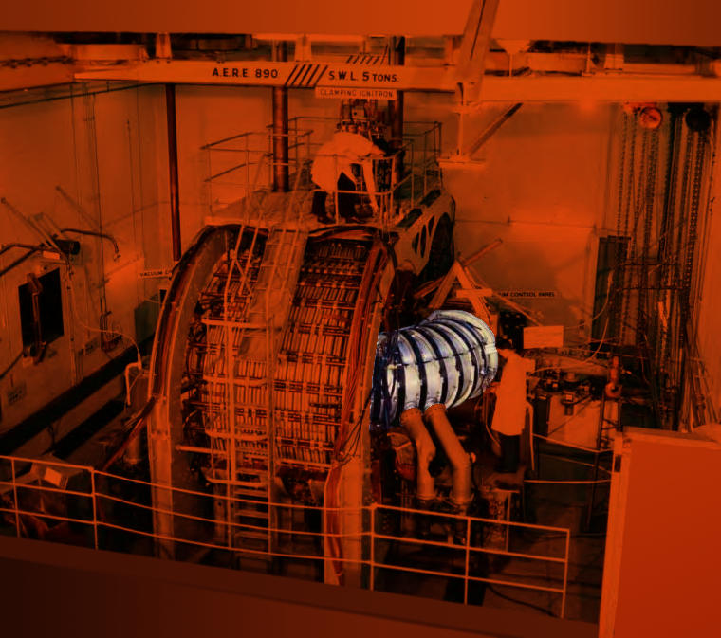
m3
EARLY CONCEPTS: THE CIRCULAR PINCH
Similar to linear pinch but with the cylinder bent into a ring shape to prevent energy losses – particles keep circulating instead of hitting the ends.
ZETA experiment at Harwell, UK (1950s) is shown. USA and USSR also built circular pinch devices.
18
Image: Pinch device Sandpiper, unrestricted, http://tinyurl.com/h386pvb, image on top: copyright expired, http://tinyurl.com/hop8mhk,
image: UK Atomic Energy Authority

Slide 4
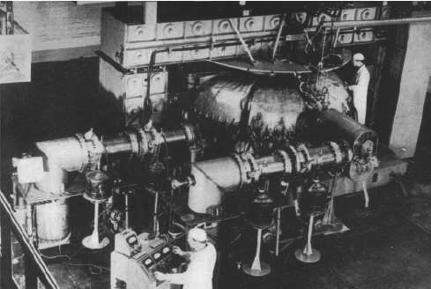
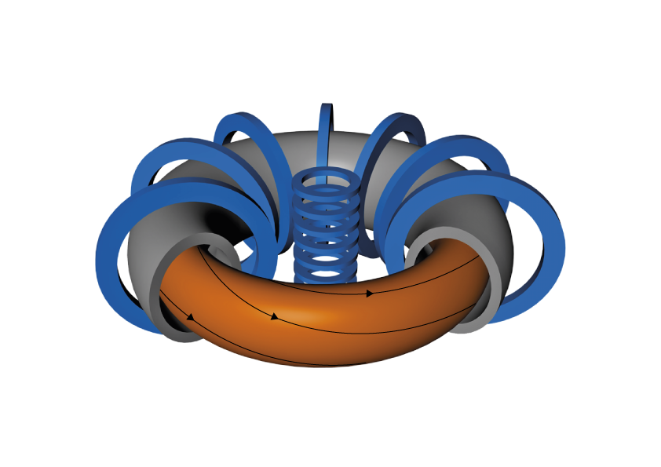
m3
THE TOKAMAK
Pioneered in the Soviet Union in the 1950s and 1960s
Improved plasma confinement by adding a second magnetic field
T3 device at Kurchatov Institute, Moscow achieved breakthrough in fusion performance – 1968
Joint European Torus (Culham, UK) is now the largest tokamak operating (since 1983)
19
Image: https://alltheworldstokamaks.wordpress.com/gallery-of-externalviews/t3
Graphic: EUROfusion, Reinald Fenke, CC BY 4.0, www.euro-fusion.org

Slide 5
m3
EUROPEAN LOCATIONS OF TOKAMAK DEVICES
1 MAST-Upgrade, Oxford, GB
1 JET Europe, Oxford, GB
2 ASDEX Upgrade, Garching, DE
3 TCV Lausanne, CH
4 Wendelstein 7-X, Greifswald, DE
5 ISTTOK, Lisbon, PT
6 WEST, Cadarache, F
7 PSI-2, Jülich, DE
8 Pilot-PSI/Magnum-PSI, Eindhoven, NL
8
4
1
7
2
3
6
5
20
Graphic: EUROfusion, Reinald Fenke, CC BY 4.0, www.euro-fusion.org

Slide 6
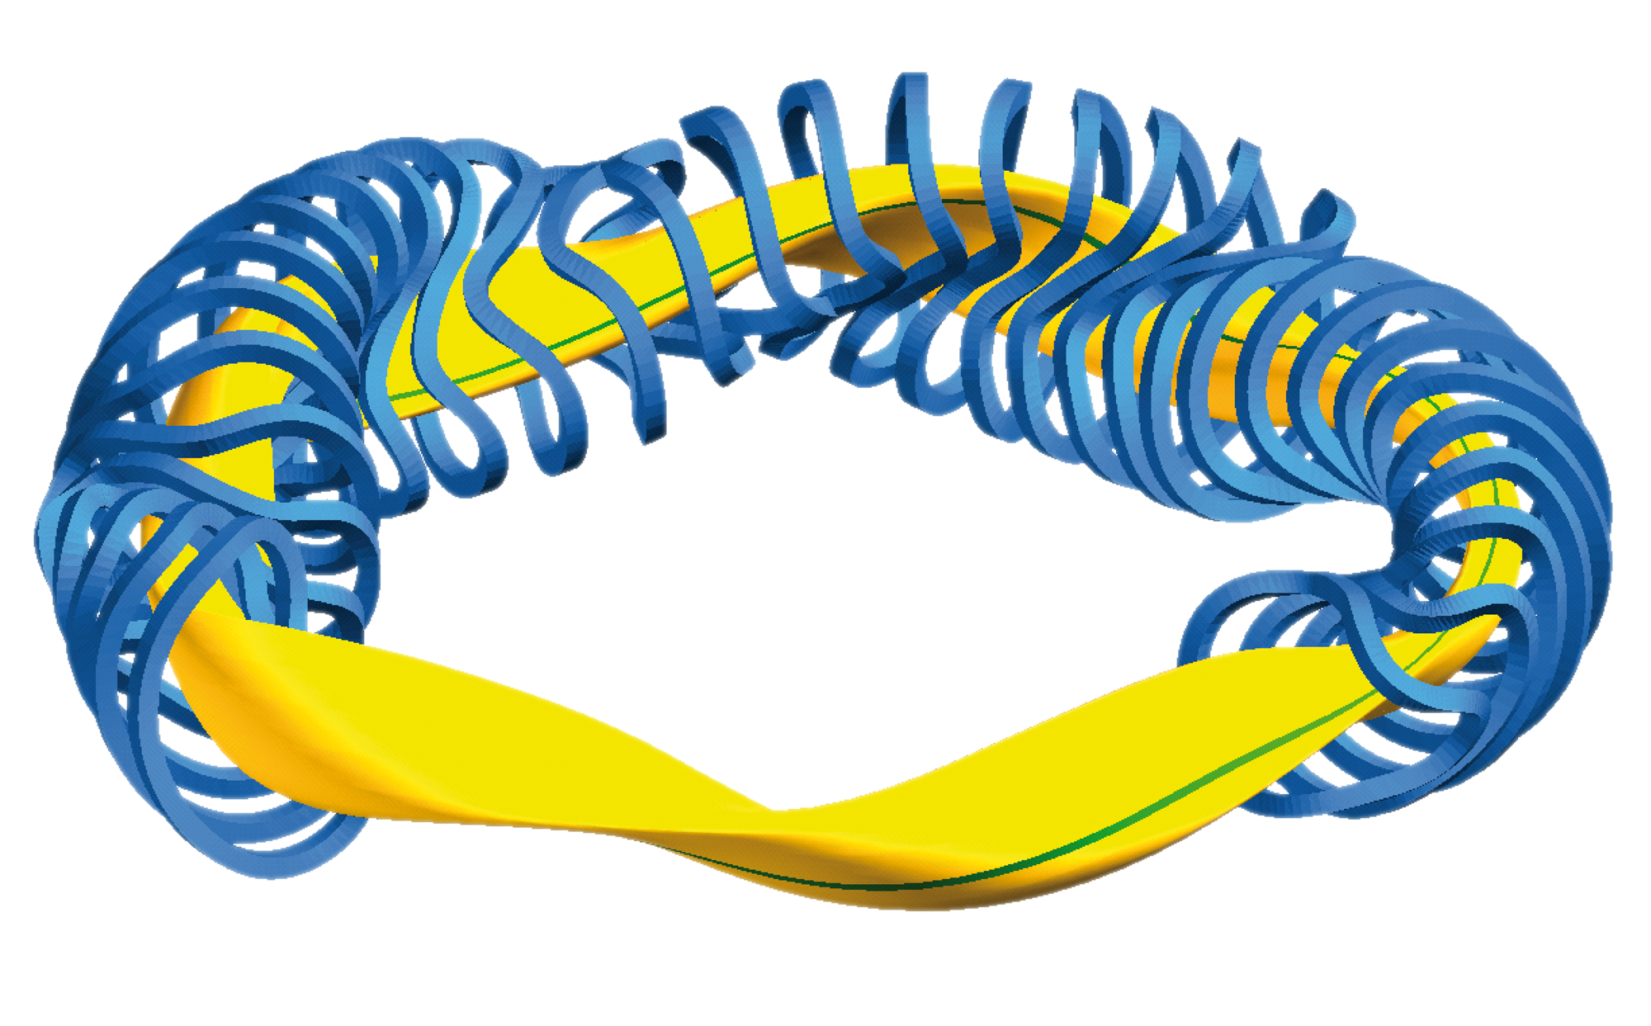
m3
STELLARATOR
Alternative magnetic fusion concept that might be suitable for a power plant. Dates from the 1950s. Similar to tokamak but with helical magnetic field generated by twisted coils. Promises steady state operation.
21
Image: Max Planck institute for Plasmaphysics, www.ipp.mpg.de

Slide 7
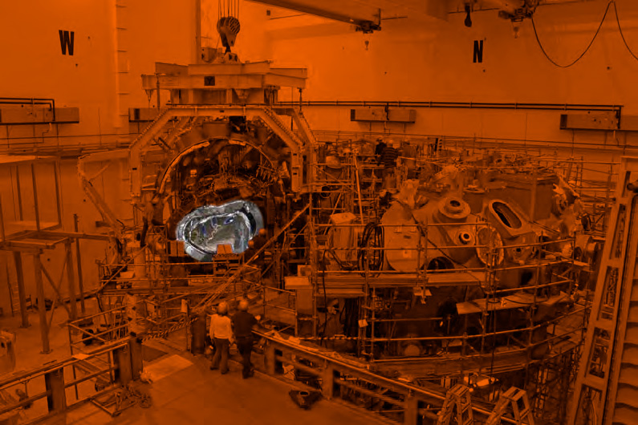
m3
WENDELSTEIN 7-X
New stellarator in Greifswald, Germany. Operating from 2015.
22
Image (modified): Max Planck institute for Plasmaphysics, www.ipp.mpg.de

