Slide 1
m4
m4
WHAT IS A TOKAMAK?
Graphic: EUROfusion, Reinald Fenke, CC BY 4.0, www.euro-fusion.org

Slide 2
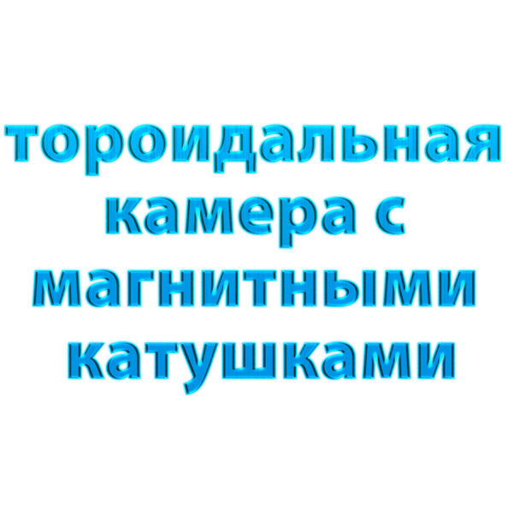
m4
EXPLANATION
Tokamak is a Russian acronym meaning donut-shaped vessel surrounded with magnets.
The tokamak is the most advanced device towards the production of electricity from fusion energy.
It consists of
Tokamak itself
Heating systems
Measurement systems

Slide 3
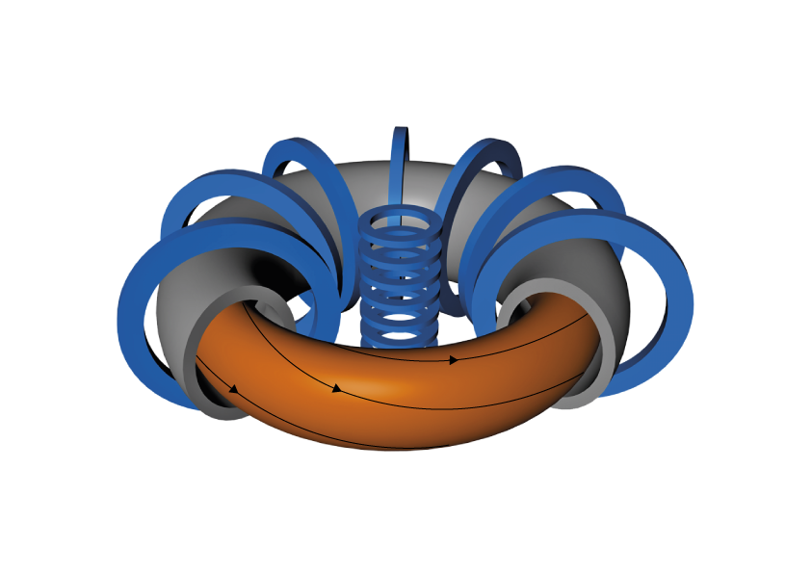
m4
BASICS OF A TOKAMAK
It consists of
Metallic vessel to contain the plasma
Magnetic field coils to
guide the plasma particles
generate a current in
the plasma
shape the plasma
Coils
Vessel
Magnetic field line
Plasma
Graphic: EUROfusion, Reinald Fenke, CC BY 4.0, www.euro-fusion.org

Slide 4
m4
TOKAMAKS IN FIGURES
Size:
Radius 0.5 – 6 m
Volume 0.01 – 100 m³
Magnetic field 1 – 8 T
~100 thousand times the earth magnetic field
Plasma current 0.1 – 8 MA
~100 thousand times the current in a domestic plug
Plasma shape – shape of
cross section
Plasma Elongation
Plasma Triangularity
Changing the plasma shape changes the plasma properties especially the confinement
JET
TCV
ITER
Low
Elongation
High
Elongation
Strong negative
Triangularity
Zero
Triangularity
Strong positive
Triangularity
Graphic: Max Planck institute for Plasmaphysics, Reinald Fenke, www.ipp.mpg.de

Slide 5
m4
MAGNETIC CONFINEMENT
The combination of the magnetic fields naturally forms a cage-like structure, consisting of a series of nested rings.
Since particles of the plasma follow the magnetic field lines, they remain confined in the vicinity of the surface of a ring.
Coils
Vessel
Magnetic field line
Plasma
Graphic: EUROfusion, Reinald Fenke, CC BY 4.0, www.euro-fusion.org

Slide 6
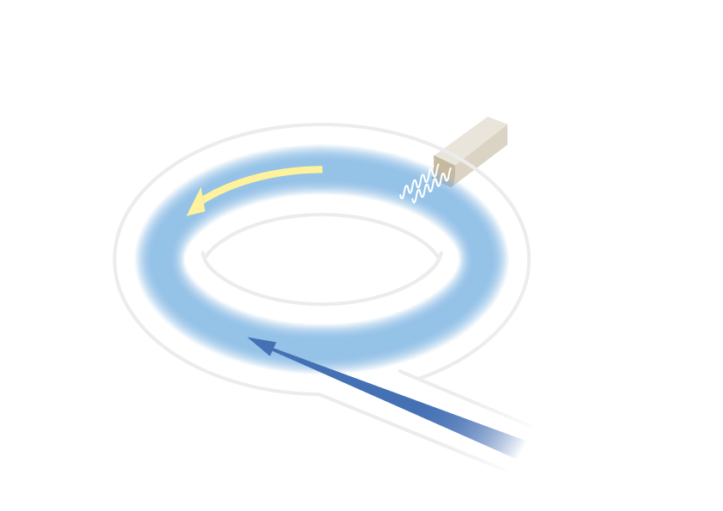
m4
PLASMA HEATING SYSTEMS
Wave heating
Injection of high frequency waves (like in a microwave oven but 100-10’000 times more power)
Wave – plasma resonance
Energy transferred to plasma
Ohmic heating
Produced by the
plasma current
Neutral beam injection
Injection of fast particles
Collisions with plasma particles
Energy transferred to plasma
Graphic: EUROfusion, Reinald Fenke, CC BY 4.0, www.euro-fusion.org

Slide 7
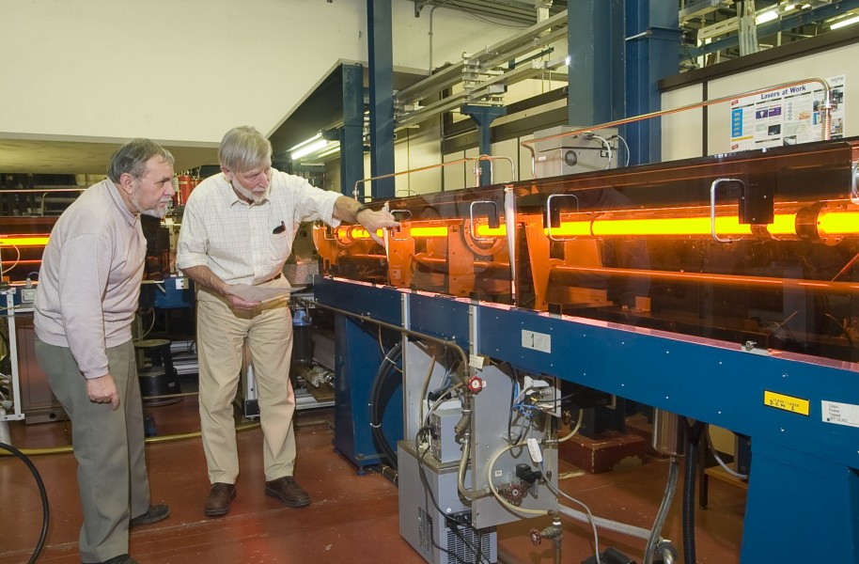
m4
PLASMA DIAGNOSTICS
MEASUREMENT SYSTEMS
It is not possible to insert
a thermometer into the
plasma … then
all systems must be based on
natural emission of the
plasma (light, particles)
interaction with laser light
(or particle beams)
to measure the
plasma density
plasma temperature
plasma emission
…
Image: EUROfusion, CC BY 4.0, www.euro-fusion.org

Slide 8
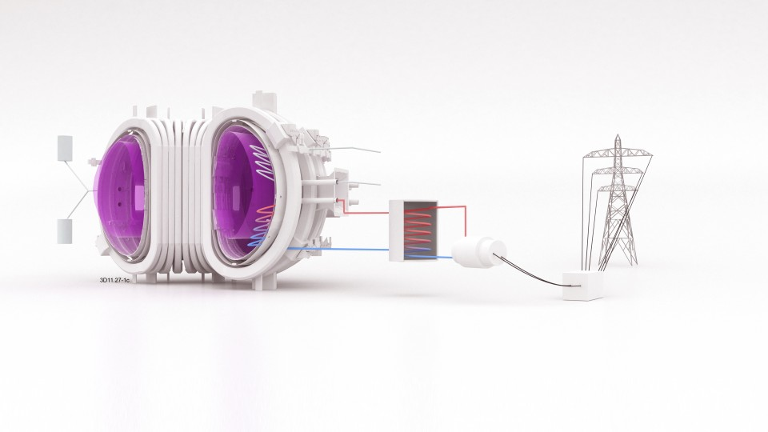
m4
PLASMA DIAGNOSTICS
Now: several systems to
diagnose the plasma, for scientific exploitation
Later: fewer systems in a commercial reactor, for
control only
30
Image: EUROfusion, CC BY 4.0, www.euro-fusion.org

Slide 9
m4
PLASMA DENSITY
Interferometry
One laser beam
Split into two beams
– One through the plasma
– One outside the tokamak
Recombine the beams
Interferometry fringes
When the plasma density increases, it delays the beam crossing the plasma and then induces interferences when it is recombined with the other beam.
Counting the interferences gives the plasma density.
Detector
Plasma
In phase
+ =
Out of phase
+ =
Laser
Half-silvered mirror or Beam splitter
Image: Swiss Plasma Centre, EUROfusion

Slide 10
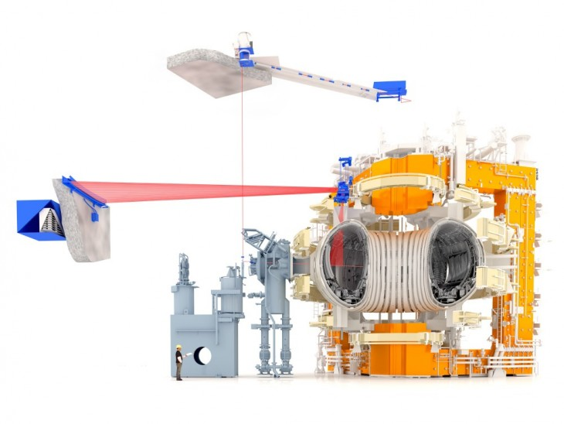
m4
THOMSON SCATTERING
Laser light is scattered by the electrons in the plasma.
Due to Doppler effect, the frequency of the scattered light is shifted.
Collected light shows a continuous spectrum around the laser frequency.
The width of the spectrum increases with electron temperature.
Image: EUROfusion, CC BY 4.0, www.euro-fusion.org

