Slide 1
m5
m5
JET
The »Joint European Torus«
Graphic: EUROfusion, Reinald Fenke, CC BY 4.0, www.euro-fusion.org

Slide 2
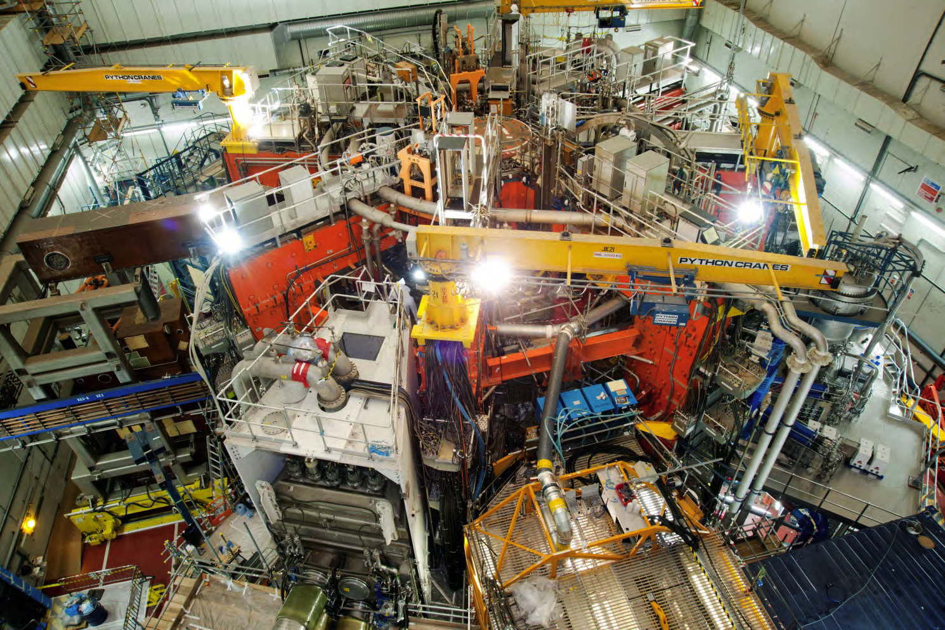
m5
JET – A COLLECTIVE EUROPEAN EXPERIMENT TO INVESTIGATE THE POTENTIAL OF FUSION POWER
Image: EUROfusion, CC BY 4.0, www.euro-fusion.org

Slide 3
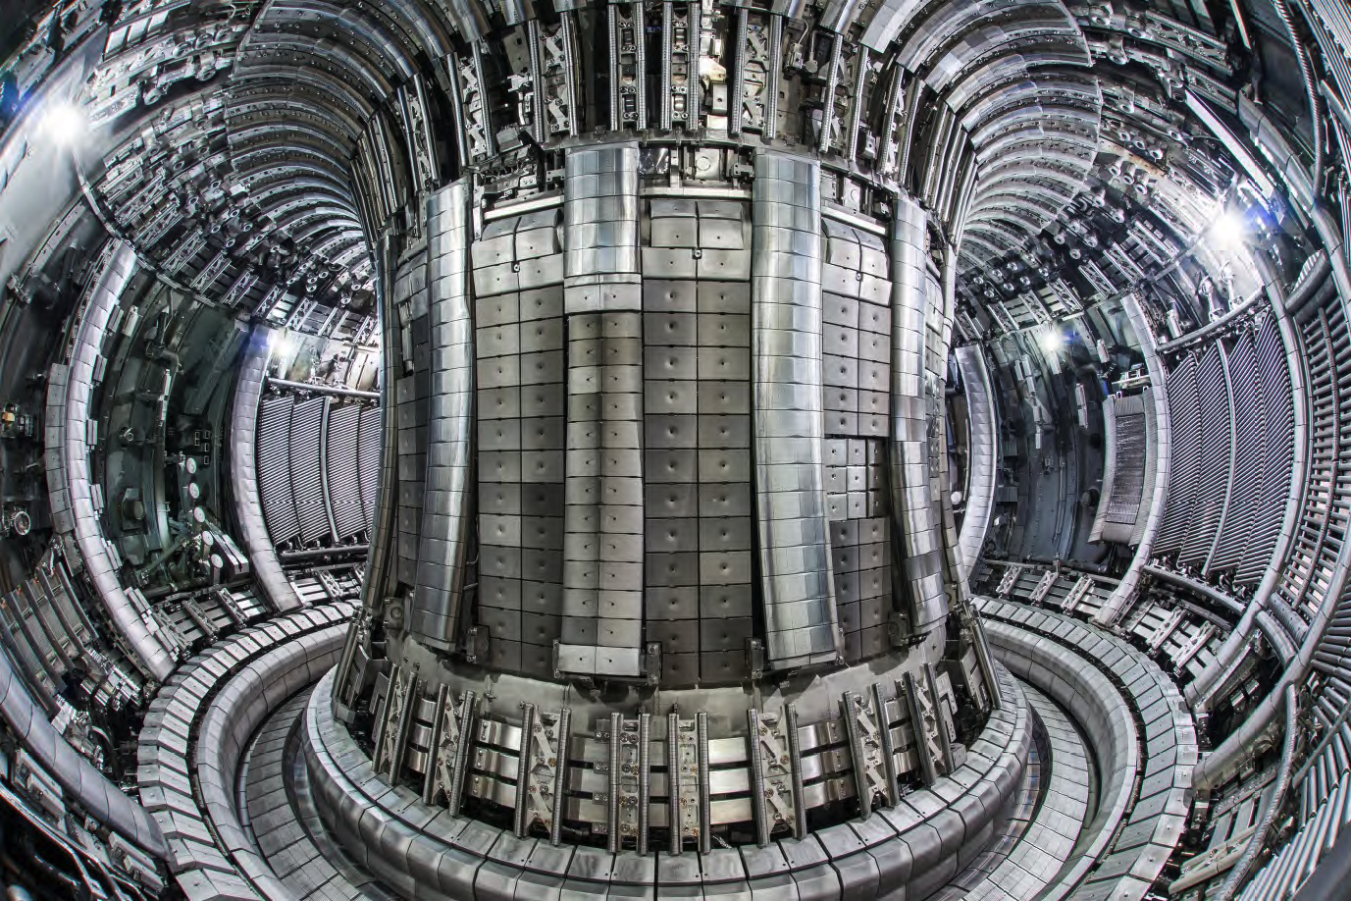
m5
JET – THE WORLD’S LARGEST TOKAMAK
This device is used by researchers from more than 40 European laboratories, co-ordinated by EUROfusion. Hosted and operated by Culham Centre for Fusion Energy in the UK.
Image: EUROfusion, CC BY 4.0, www.euro-fusion.org

Slide 4
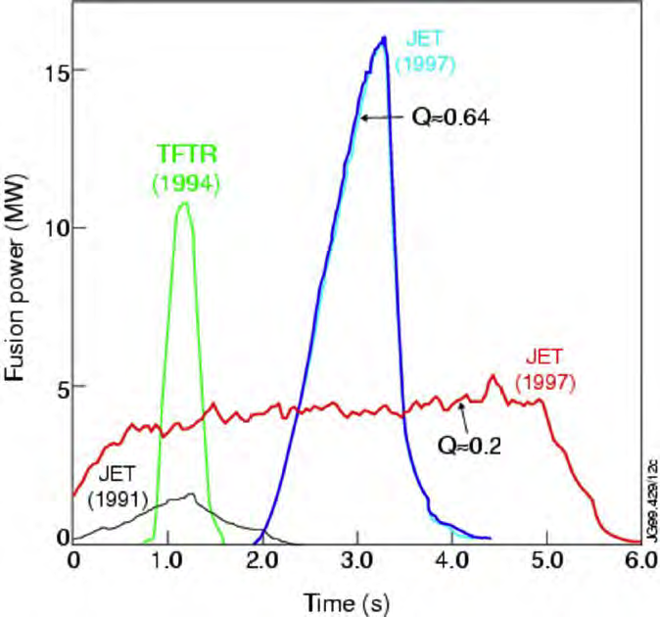
m5
JET’S HIGHLIGHTS
The first tokamak to achieve controlled deuterium-tritium fusion power (1991)
The only device currently capable of using deuterium and tritium fuel
World record of 16 megawatts of fusion power (1997). This proved that large amounts of power can be produced from fusion; results can be scaled up to ITER and power plants.
Graphic: EUROfusion, CC BY 4.0, www.euro-fusion.org

Slide 5
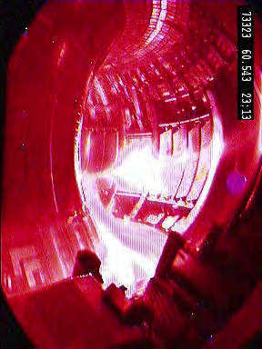
m5
JET’S SPECIFICATIONS
Plasma volume: 80 m³
Plasma radius 3 metres (major) / 0.9 metres (minor)
Magnetic field: up to 3.5 Tesla
Core temperature: up to 200 million degrees C
Pulse length: up to 60 seconds
Materials: Inconel (vessel), beryllium (wall), tungsten (divertor)
Image: EUROfusion, CC BY 4.0, www.euro-fusion.org

Slide 6
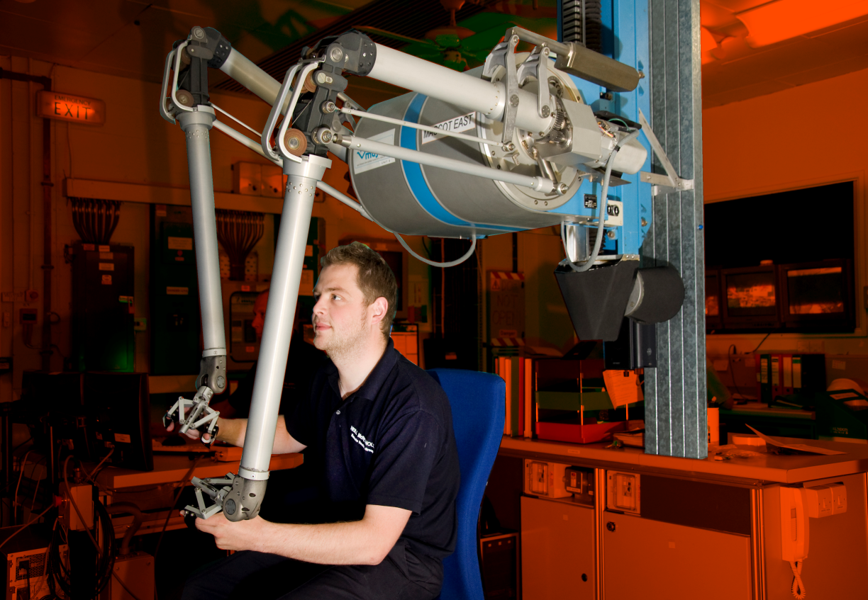
m5
REMOTE HANDLING
JET’s remote-controlled maintenance system has allowed many engineering modifications to keep pace with scientific progress. Recent installation of the ‘ITER-like’ inner wall is a good example.
Image: EUROfusion, CC BY 4.0, www.euro-fusion.org

Slide 7
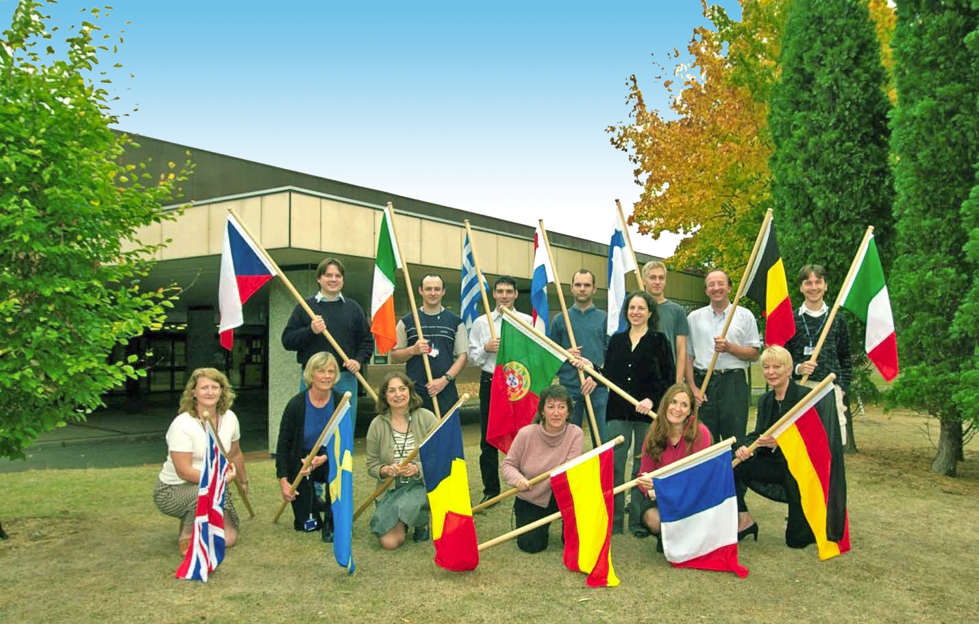
m5
A EUROPEAN SUCCESS STORY
Researchers come from 30 European countries to use JET. Over 350 scientists and engineers contribute to the programme.
Image: EUROfusion, CC BY 4.0, www.euro-fusion.org

Slide 8
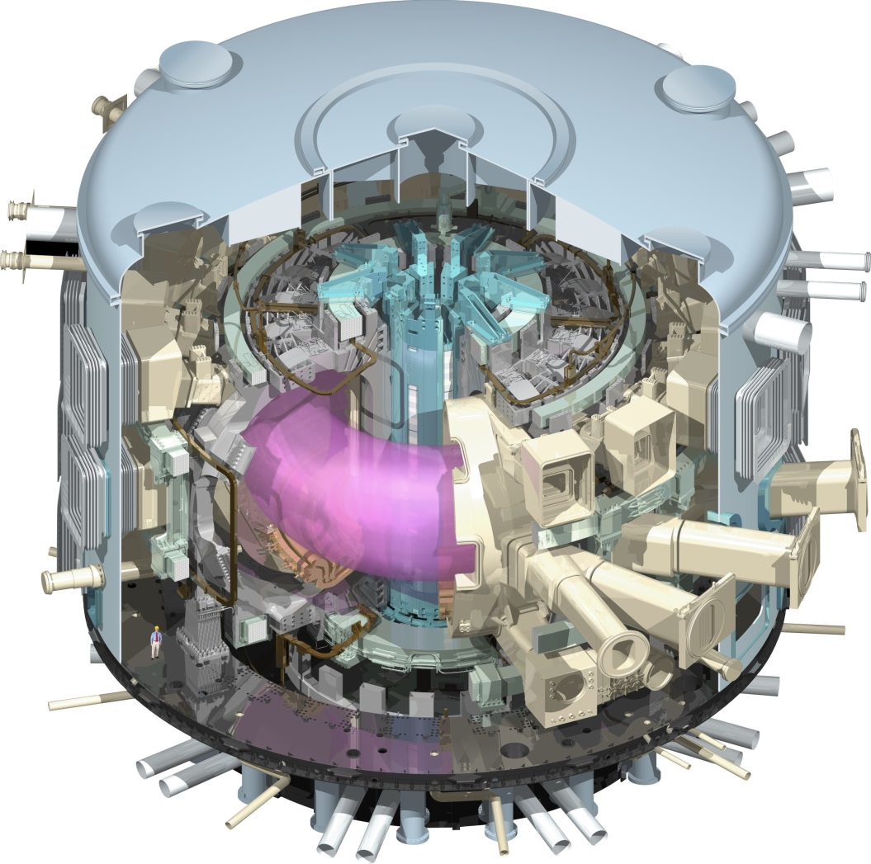
m5
JET AND ITER
JET has a key role in taking fusion forward, as one of the main test machines for ITER.
Images (from left to right): EUROfusion, CC BY 4.0, www.euro-fusion.org, ITER US, http://www.usiter.org

Slide 9
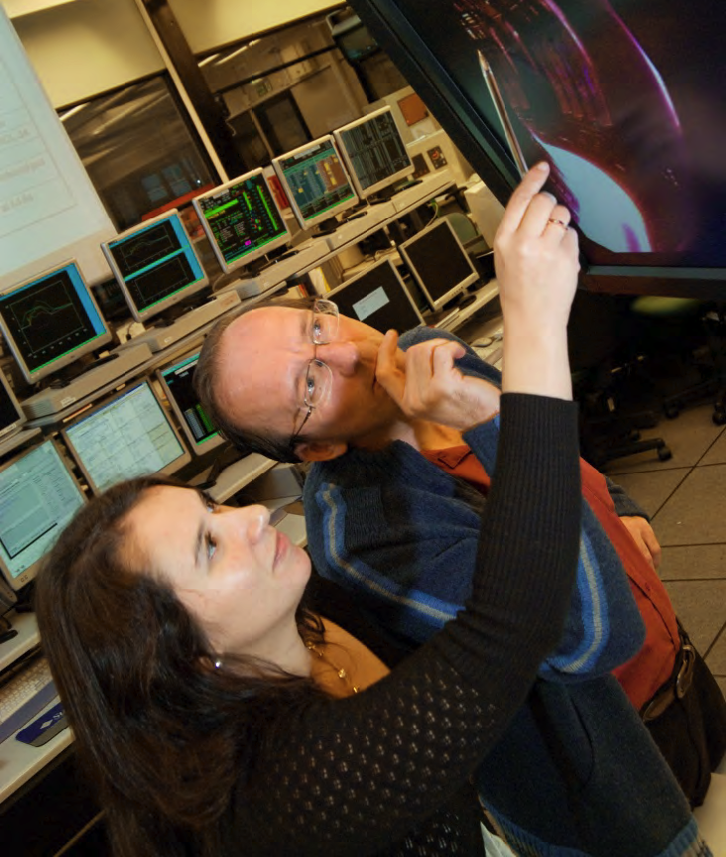
m5
FUTURE PLANS
Deuterium and tritium ITER ‘dress rehearsal’ being prepared, using JET’s unique tritium capabilities
Continue to support technical preparations and train fusion experts for ITER
Image: EUROfusion, CC BY 4.0, www.euro-fusion.org

