Slide 1
m6
m6
ITER – A GLOBAL COLLABORATION
ITER’s establishment and organisation, comparison to JET, schedule, cost
43
Graphic: EUROfusion, Reinald Fenke, CC BY 4.0, www.euro-fusion.org

Slide 2
m6
FUSION ENERGY
FOR MANKIND
1958: Atoms for Peace – worldwide agreement on the peaceful use of atomic energy.
44

Slide 3
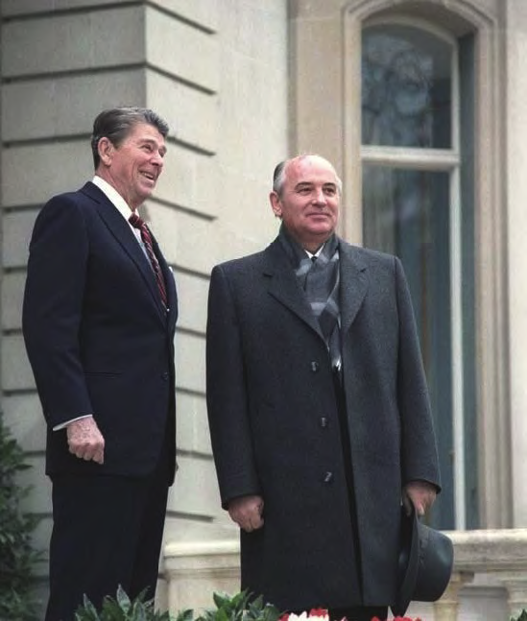
m6
ITER – FUSION
FOR MANKIND
The idea of the ITER project was outlined in 1985:
»An international experiment should be built investigating fusion energy ‘for the benefit of all mankind’«
45
Image: By White House Photo Office [Public domain], via Wikimedia Commons, http://tinyurl.com/zcfxggo

Slide 4
m6
ITER – FUSION
FOR MANKIND
The idea of the ITER project was outlined in 1985:
»An international experiment should be built investigating fusion energy ‘for the benefit of all mankind’«
46
Graphic: EUROfusion, Reinald Fenke, CC BY 4.0, www.euro-fusion.org

Slide 5
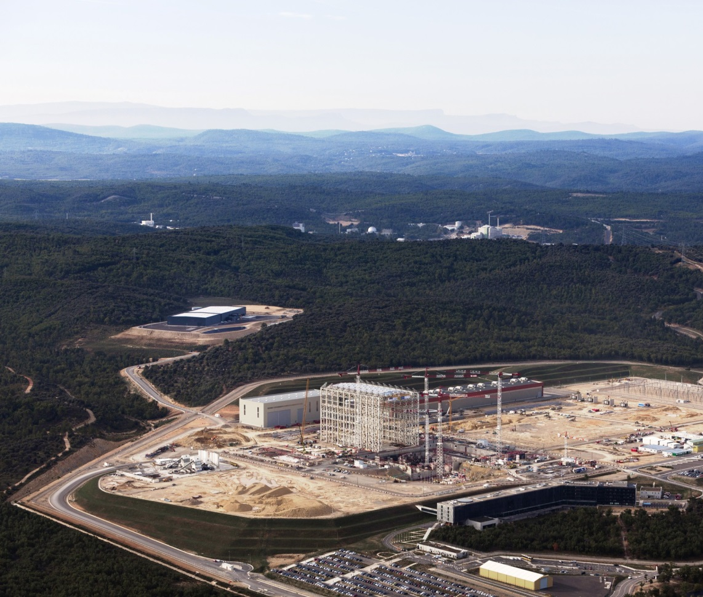
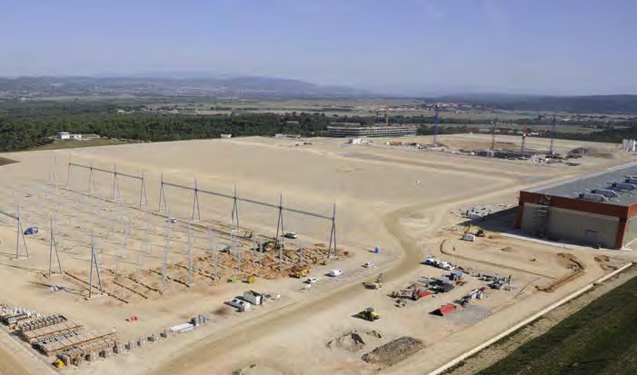
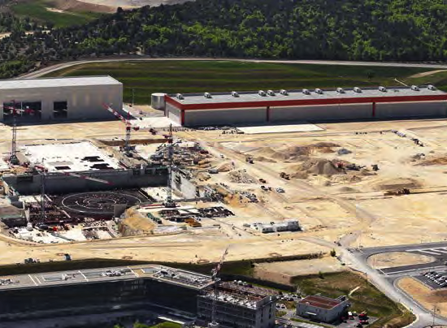
m6
ITER SITE
180 hectares of land in St-Paul-lez-Durance, in southern France
Scientific buildings and facilities are constructed on the approximate size of 60 soccer fields
2009
2015
2012
47
Image: © MatthieuCOLIN.com Images: ITER Organization, www.iter.org

Slide 6

m6
ITER – SCIENTIFIC GOALS
to demonstrate the feasibility of fusion as an energy source
to prove integrated operation of technologies for a fusion power plant
to test concepts for a tritium breeding module
to produce 500MW of fusion power, 10 times the input power
48
Image: ITER US, www.usiter.org

Slide 7
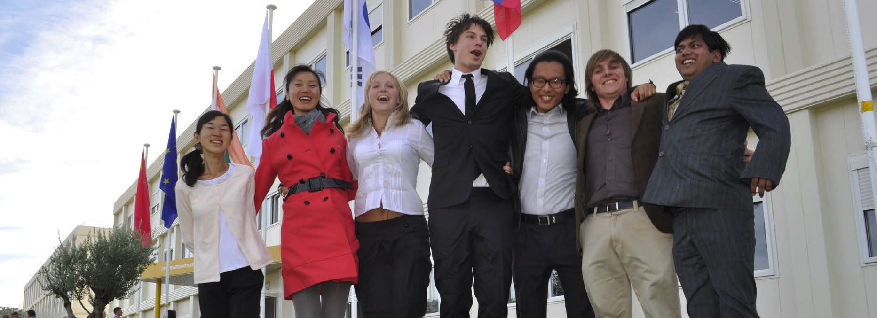
m6
BENEFITS OF ITER
ITER paves the way to a CO₂-free, sustainable energy source
ITER benefits from the cultural and disciplinary diversity of its staff
ITER helps to establish international collaboration
49
Image: ITER Organization, www.iter.org

Slide 8
m6
CHALLENGES
FOR ITER
ITER is tackling different safety & industrial standards, employment schemes, measure standards …
ITER is challenged by differences in culture and mentality of its staff
European
Union
Russion
Federation
South
Korea
USA
China
Japan
India
50
Graphic: EUROfusion, CC BY 4.0, www.euro-fusion.org

Slide 9
m6
ORGANIZATION
ITER parties provide 90% of components.
Relative contribution to the estimated
$20-Billion construction costs.
51
Graphic: EUROfusion, Reinald Fenke, CC BY 4.0, www.euro-fusion.org, data: ITER

Slide 10
m6
ITER, THE NEW GENERATION
JET
ITER
 | JET | ITER
Radius | 3 m | 6.2 m
Volume | 90 m³ | 840 m³
Power factor Q | 0.65 | 10
Fusion Power | 16 MW | 500 MW
52
Graphic: EUROfusion, Reinald Fenke, CC BY 4.0, www.euro-fusion.org

Slide 11
m6
SCHEDULE
ITER will start operation in the 2020’s.
ITER will run experiments with real fusion fuel in the 2030’s.
ITER
53

Slide 12
m6
COST
Construction cost
€15 billion
(€15 thousand million)
Europe’s Domestic Agency ‘Fusion for Energy’ manages €6.6 billion
54
Graphic: EUROfusion, Reinald Fenke, CC BY 4.0, www.euro-fusion.org, data: ITER Organization

Slide 13
m6
ITER BUDGET
As the host party, the EU covers about 45% of ITER's costs.
Overall ITER budget
2.707 M€/2014-2020
United States
European
Union
India
9
9
Japan
9
%
46
9
China
9
9
India
Russian
Federation
55
Graphic: Pie chart, EUROfusion, Reinald Fenke, data: https://tinyurl.com/lanjobg

Slide 14
m6
A COMMON PHENOMENON
Projects funded in
the Public Sector
x times cost overrun
Hubble Space Telescope
CERN
Suez canal
Sydney Opera house
Concord supersonic
Elb-Philharmonie
Channel tunnel UK-France
ITER
62
30
20
15
12
4
3
3
56
Graphic: EUROfusion, Reinald Fenke, CC BY 4.0, www.euro-fusion.org, data: ITER Organization

