Slide 1
m6
m7
MST MEDIUM DEVICES
57
Graphic: EUROfusion, Reinald Fenke, CC BY 4.0, www.euro-fusion.org

Slide 2
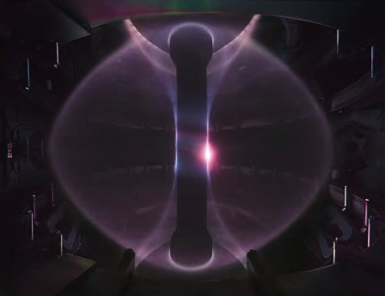
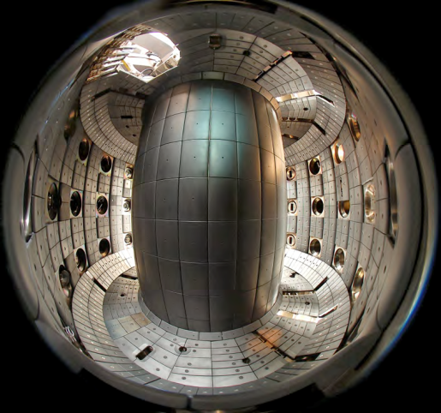
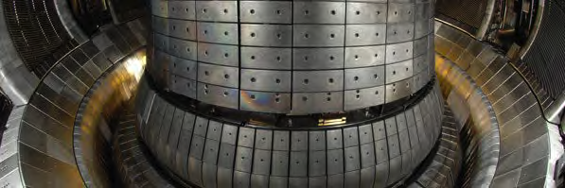
m7
MST: Medium Size Tokamaks
Three European devices have been selected for input to the Fusion Roadmap in parallel with JET. These devices are:
MAST Upgrade
TCV
ASDEX Upgrade
Images (left to right, to down) CCFE, www.ccfe.ac.uk; Swisse Plasma
Centre, http://spc.epfl.ch; Max Planck institute for Plasmaphysics,
www.ipp.mpg.de
Image: Max Planck institute for Plasmaphysics, www.ipp.mpg.de, modified
58

Slide 3
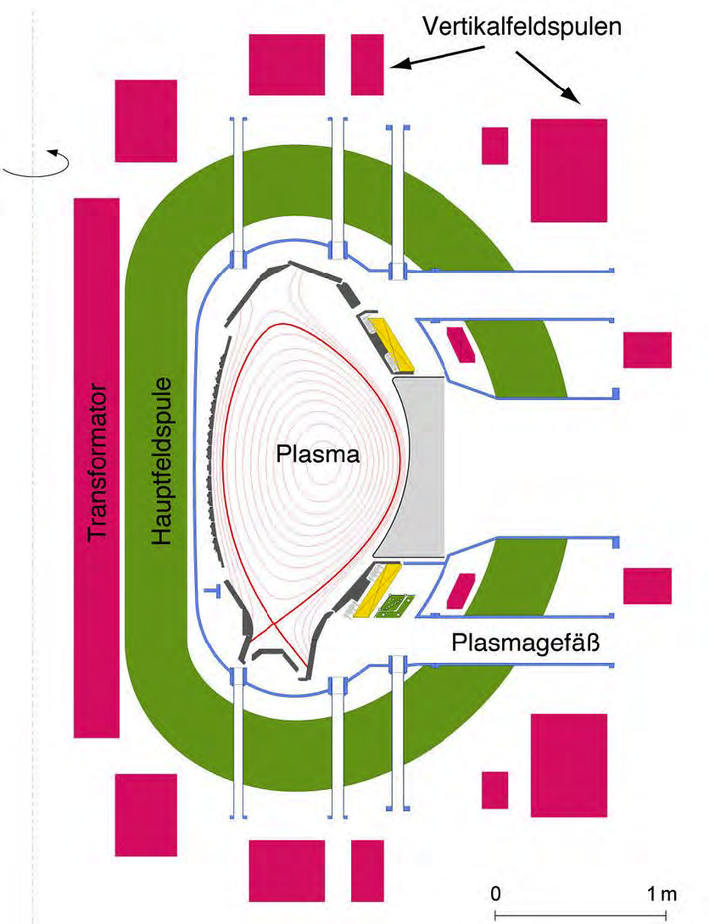
m7
ASDEX Upgrade – AxiSymmetric Divertor EXperiment
Located near Munich, Germany. Operated since 1991 by IPP/MPG
A new device – not an upgrade from the former ASDEX (now in China)
Strong heating capabilities
Tungsten wall
Major radius: 1.6m
Minor radius: 0.6m
Elongation: 1.6
Magnetic field: 3.9T
Plasma current: 2MA
Heating systems
NBI: 20MW
ICRH: 6MW
ECRH: 4MW
59
Image: Max Planck institute for Plasmaphysics, www.ipp.mpg.de

Slide 4
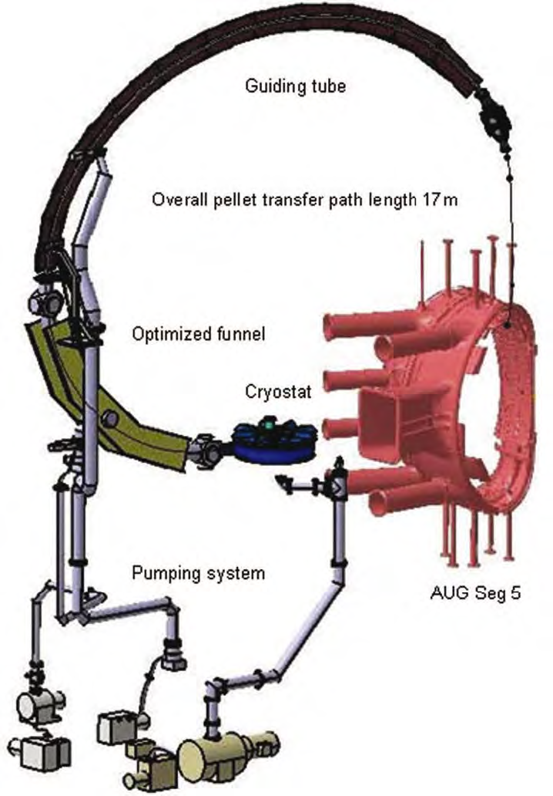
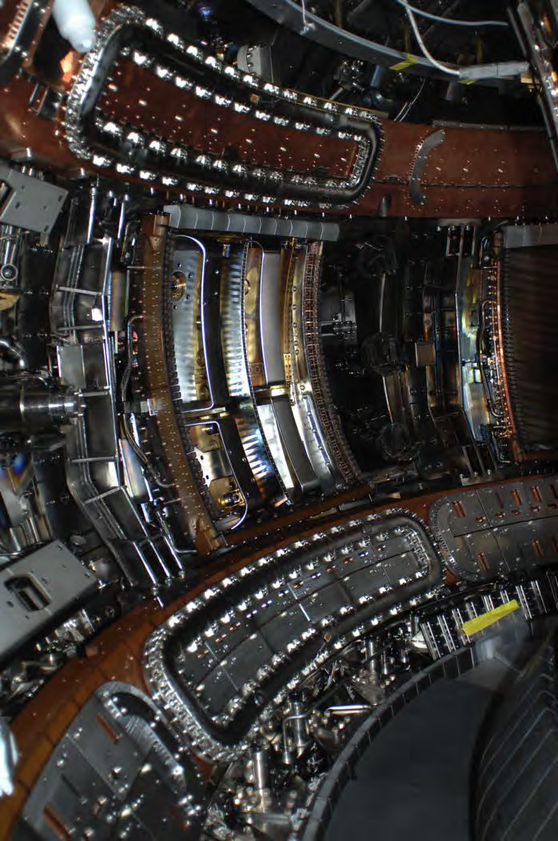
m7
ASDEX Upgrade – characteristics
Solid Deuterium pellet injection
To fuel the plasma
ELM* suppression/mitigation coils
To mitigate the harmful effect of ELMs
*ELM is an instability which occurs in short periodic bursts during the H-mode in divertor tokamaks
60
Image: Max Planck institute for Plasmaphysics, www.ipp.mpg.de

Slide 5
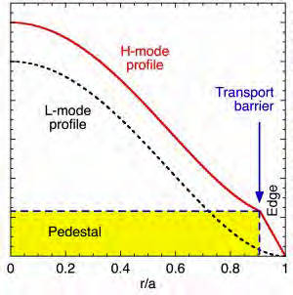
m6
m7
ASDEX UPGRADE – SALIENT RESULTS
An operational regime with improved confinement was discovered in ASDEX
ASDEX Upgrade continues to study the improved confinement mode
To be used in first reactors (ITER)
Characterisation of the plasma – wall interaction. Investigations on
Plasma configuration – without contact with the walls (diverted configuration)
Plasma edge regime – different particle and heat flux to the wall (detachment)
Plasma wall material – Carbon before, now Tungsten
61
Image: Max Planck institute for Plasmaphysics, www.ipp.mpg.de

Slide 6
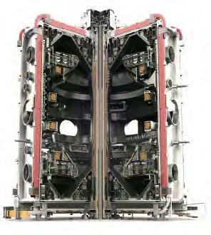
m6
m7
MAST UPGRADE – MEGA AMPERE SPHERICAL TOKAMAK
Located near Culham, UK. MAST was operated since 1999 by CCFE
Spherical tokamak
Thin central post
High plasma shaping capability
Major radius: 0.85m
Minor radius: 0.65m
Elongation: 2.6
Magnetic field: 0.52T
Plasma current: 1.45MA
Heating systems
NBI: 5MW
62
Image: CCFE, www.ccfe.ac.uk

Slide 7
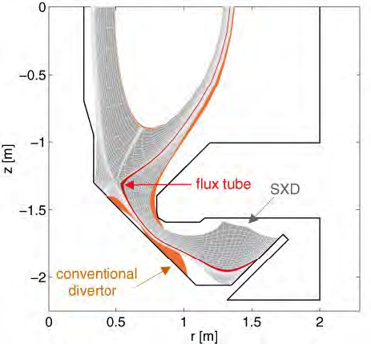
m6
m7
MAST UPGRADE – CHARACTERISTICS
Spherical tokamak
Large minor radius compared to major radius
Thin central column
Better confinement in high field region
High shaping capability
Single null and double null divertor
Super-X divertor, a magnetic configuration that strongly reduces the particle and heat impact onto the walls
Fast imaging capabilities
To analyse filamentary structures at the plasma edge
MAST-Upgrade
More heating power, higher toroidal field, higher plasma current, increased pulse length
63
Image: CCFE, www.ccfe.ac.uk

Slide 8
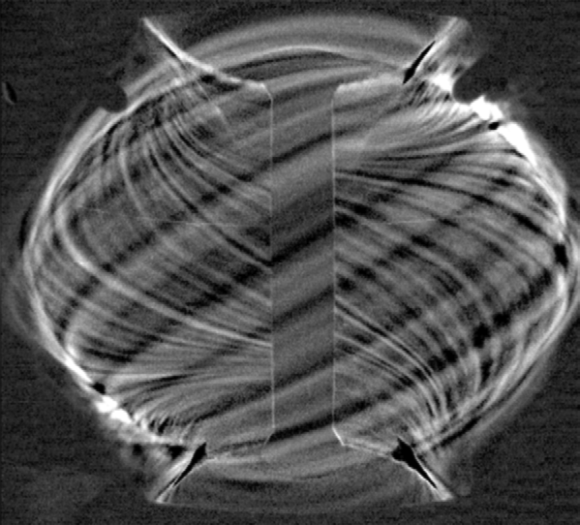
m6
m7
MAST UPGRADE – SALIENT RESULTS
Improved understanding of the high confinement mode (H-mode)
Fast, wide angle camera reveals filament structures at the plasma edge
Evolution of the total light emitted by the plasma reveals the repeated energy and material bursts
64
Image: CCFE, www.ccfe.ac.uk

Slide 9
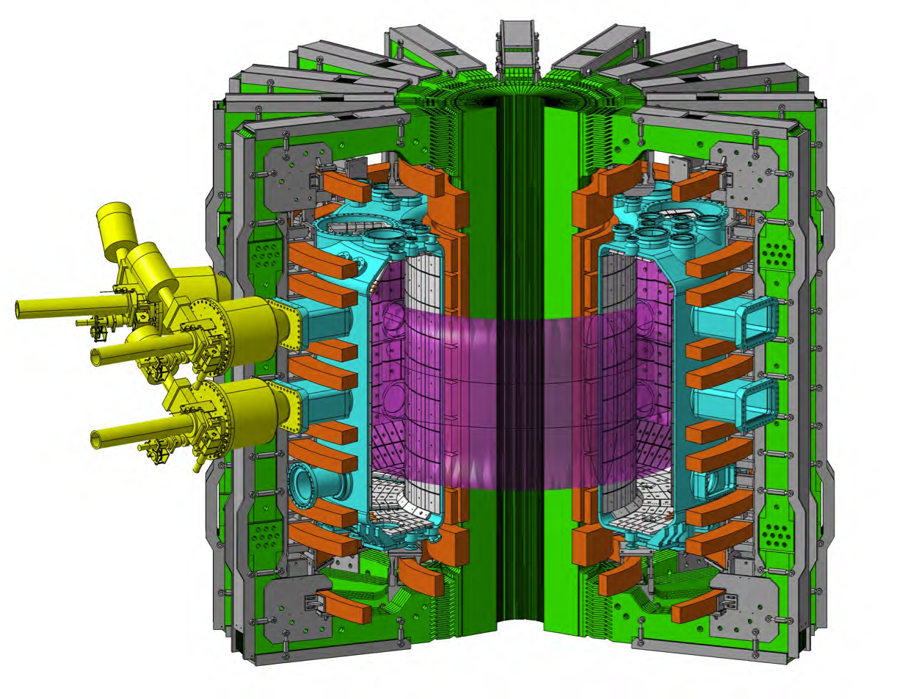
m6
m7
TCV – TOKAMAK À CONFIGURATION VARIABLE
Located in Lausanne, Switzerland. Operated since 1992 by CRPP/EPFL
Very high plasma shaping capabilities. High ECRH power. Flexible microwave launching system. Real time plasma control.
Major radius: 0.9m
Minor radius: 0.25m
Elongation: 0.9 – 2.7
Magnetic field: 1.5T
Plasma current: 1MA
Heating systems
ECRH: 4.5MW
NBI: 1MW (2015)
65
Image: Swiss Plasma Centre, http://spc.epfl.ch

Slide 10
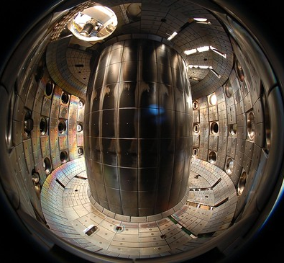
m6
m7
TCV – CHARACTERISTICS
16 independent poloidal field coils
To shape the plasma
7 independent ECH launchers
To aim the microwave beams at efficient locations
TCV Upgrades (2014-16)
1MW NBI, 2MW ECH
66
Image: Swiss Plasma Centre, http://spc.epfl.ch

Slide 11
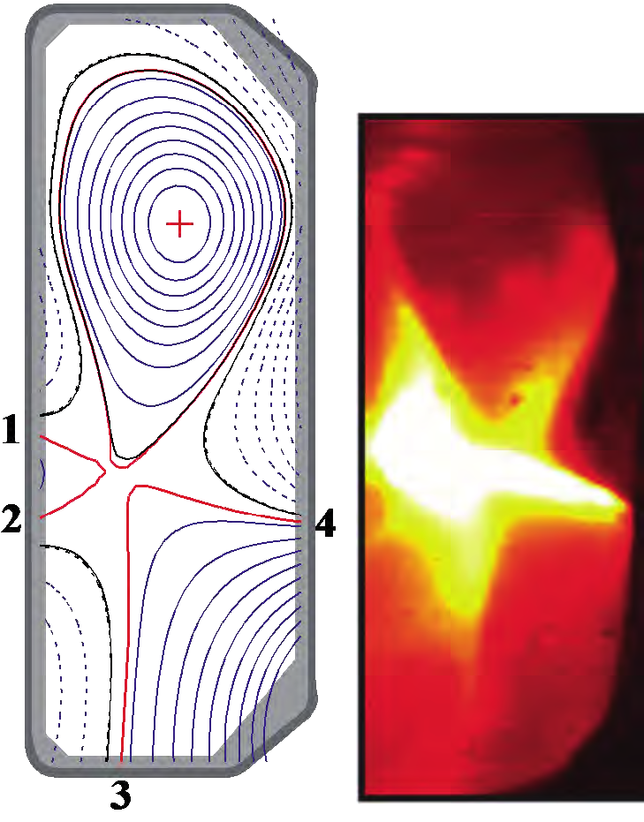
m6
m7
TCV – SALIENT RESULTS
Snowflake configuration
4 »legs« connect to the wall to distribute exhaust power
Current generation by microwaves
To mitigate the need of maintaining the plasma current by induction
100% »bootstrap«
Self-driven plasma current
Quiescent stationary H-mode
Good plasma confinement without energy or particle losses in burst mode
67
Image: Swiss Plasma Centre, http://spc.epfl.ch

