Slide 1
m6
m8
ALTERNATIVE CONCEPTS
Inertial confinement fusion: concept, description, direct vs. indirect drive
ICF facilities around
the World
Non-mainstream concepts: Cold fusion and Bubble fusion
Thermonuclear weapons
68
Graphic: EUROfusion, Reinald Fenke, CC BY 4.0, www.euro-fusion.org

Slide 2
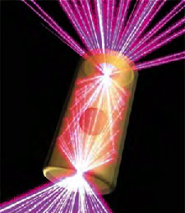
m6
m8
INERTIAL CONFINEMENT FUSION
The plasma fuel is heated and compressed by a large number of energetic (~ MJ) laser beams.
Plasma density is very high: up to 100 times denser than lead.
Confinement time is very short:
10⁻¹⁰ seconds.
69
Image: Lawrence Livermore National Laboratory

Slide 3
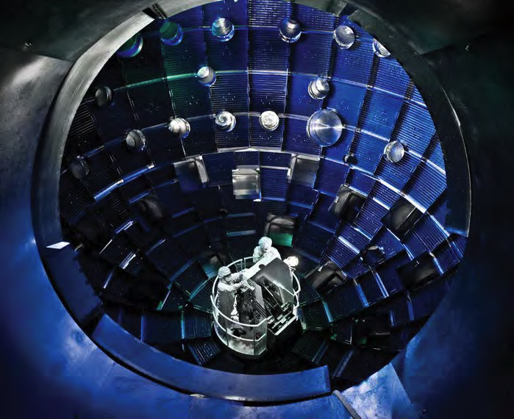
m6
m8
A VERY LARGE NUMBER OF LASER BEAMS IS REQUIRED FOR INERTIAL CONFINEMENT
Because of symmetry conditions, the target must be illuminated uniformly.
The interaction takes place inside a large spherical vacuum chamber.
70
Image: Lawrence Livermore National Laboratory

Slide 4
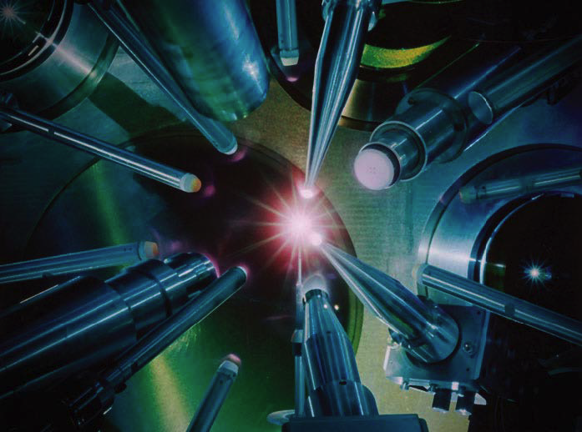
m6
m8
INERTIAL CONFINEMENT FUSION
Energetic beams of lasers or particles are used to compress and heat a small mass of fusion fuel.
The fuel undergoes nuclear fusion and burns.
71
Image: Lawrence Livermore National Laboratory

Slide 5
m6
m8
INERTIAL CONFINEMENT FUSION IN FOUR STEPS:
1
2
3
4
lasers shine on the target
the target is compressed
Ignition happens
the target
burns
72
Graphic: EUROfusion, Reinald Fenke, CC BY 4.0, www.euro-fusion.org

Slide 6
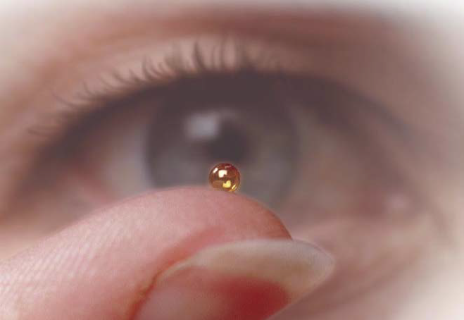
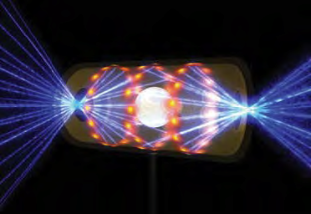
m6
m8
THERE ARE TWO APPROACHES FOR ICF
Direct drive Laser light is shot directly at a tiny spherical capsule filled with frozen deuterium and tritium
Indirect drive
The capsule is placed inside a golden cylinder (hohlraum) and irradiated by x-rays
73
Image: Lawrence Livermore National Laboratory

Slide 7
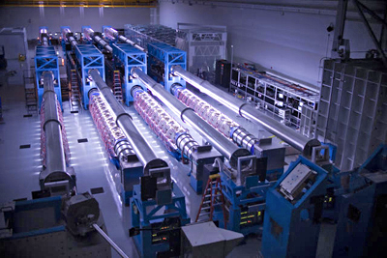
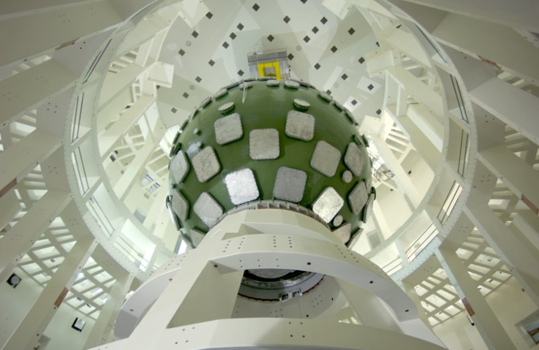
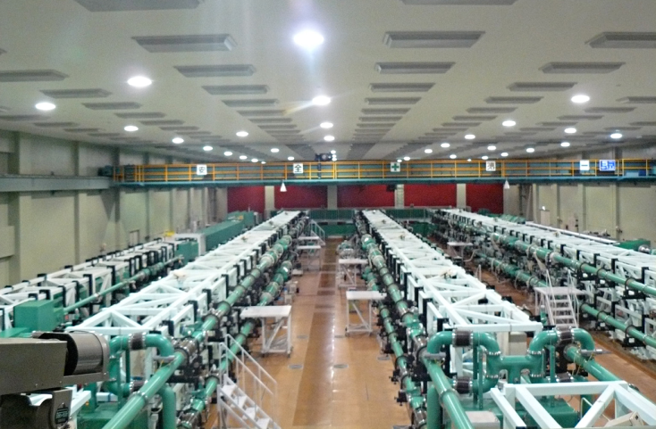
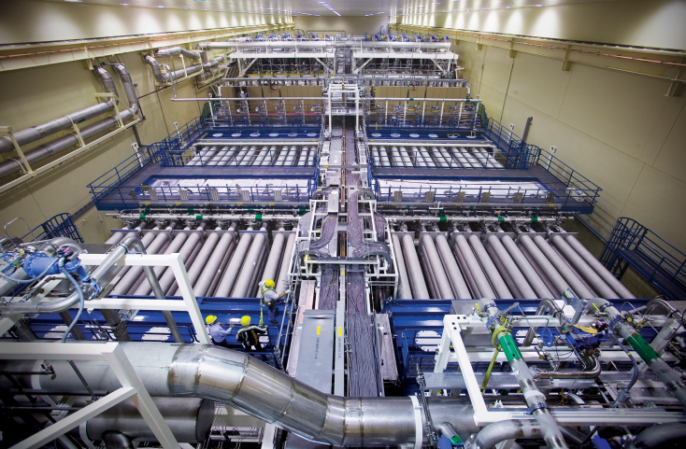
m6
m8
ICF FACILITIES AROUND THE WORLD
OMEGA EP
Laser Megajoule
Images (left-right-top-down):
OMEGA EP University of Rochester – Laboratory for Laser Energetics, USA
LASER Megajoule
Image CEA, France
GEKKO XII, Osaka University, Japan
NIF: (NIF/Lawrence Livermore National Laboratory), USA
74
GEKKO XII
NIF

Slide 8
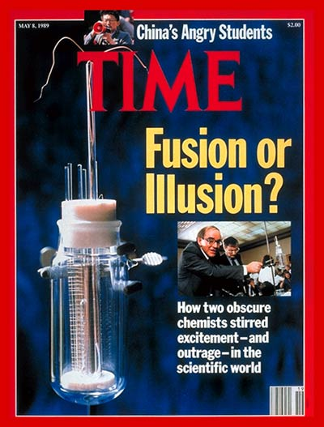
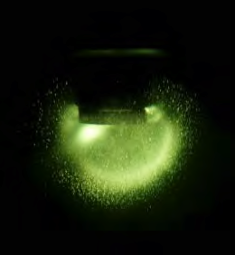
m6
m8
NON-MAINSTREAM CONCEPTS
Cold fusion
alleged to happen at room temperature
early (1989) »successful« experiments not replicated consistently
no theoretical or practical model
Bubble fusion (or sonofusion)
alleged to happen inside collapsing gas bubbles created by ultrasounds
first announced in 2002
subsequent tests were controversial, even with accusations of forged data
75

